Slide 1
Transformations & Scene Graphs

Slide 2

Recall: The Vector Graphics Pipeline
Define Object Geometry
Transform Objects
Define a “window” on the world
Render the window

Slide 3
Today’s topic: Transformation of Objects
Define Object Geometry
Transform Objects
Define a “window” on the world
Render the window

Slide 4
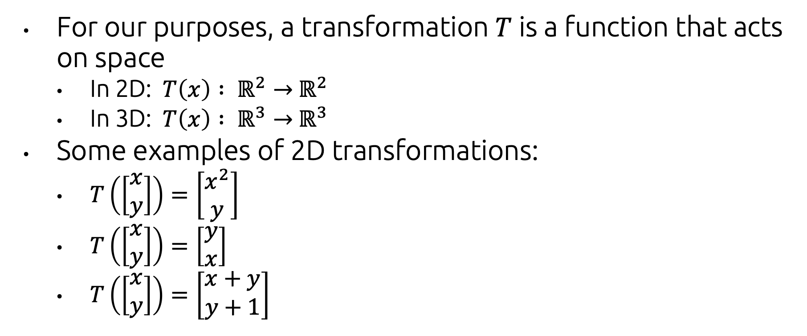
What do we mean by “transformation?”
For our purposes, a transformation $T$ is a function that acts on space
In 2D: $T\left(x\right) : ℝ^{2}→$ $ℝ^{2}$
In 3D: $T\left(x\right) : ℝ^{3}→$ $ℝ^{3}$
Some examples of 2D transformations:
$T\left(\left[\begin{matrix}x \\ y\end{matrix}\right]\right)=\left[\begin{matrix}x^{2} \\ y\end{matrix}\right]$
$T\left(\left[\begin{matrix}x \\ y\end{matrix}\right]\right)=\left[\begin{matrix}y \\ x\end{matrix}\right]$
$T\left(\left[\begin{matrix}x \\ y\end{matrix}\right]\right)=\left[\begin{matrix}x+y \\ y+1\end{matrix}\right]$

Slide 5
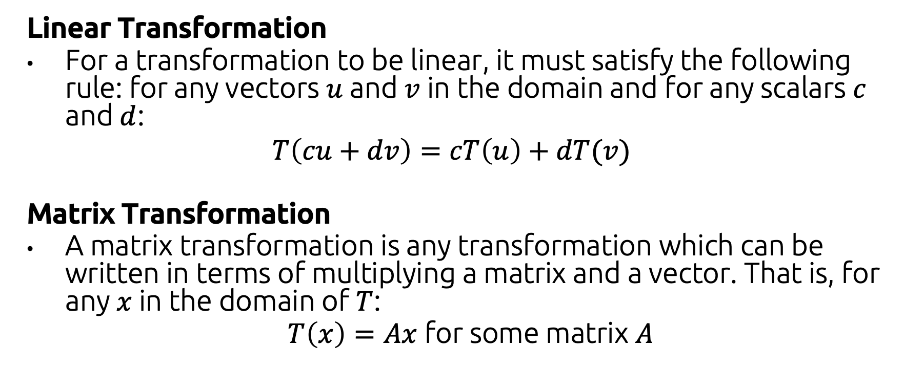
Special Types of Transformations
Linear Transformation
For a transformation to be linear, it must satisfy the following rule: for any vectors $u$ and $v$ in the domain and for any scalars $c$ and $d$:
$$T\left(cu+dv\right)=cT\left(u\right)+dT(v)$$
Matrix Transformation
A matrix transformation is any transformation which can be written in terms of multiplying a matrix and a vector. That is, for any $x$in the domain of $T$:
$T\left(x\right)=Ax$ for some matrix $A$

Slide 6
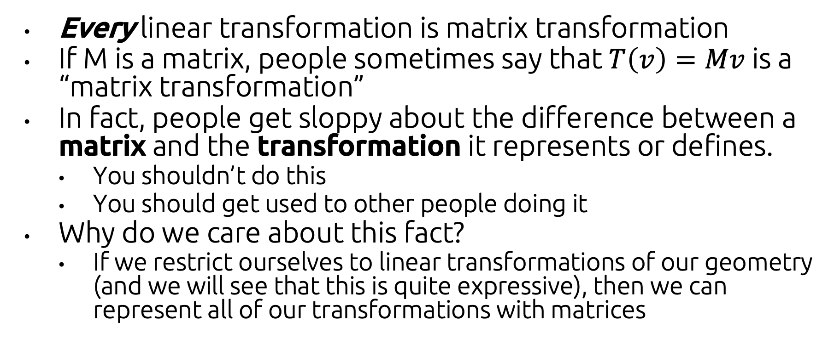
Slightly Amazing Fact:
Every linear transformation is matrix transformation
If M is a matrix, people sometimes say that $T\left(v\right)=Mv$ is a “matrix transformation”
In fact, people get sloppy about the difference between a matrix and the transformation it represents or defines.
You shouldn’t do this
You should get used to other people doing it
Why do we care about this fact?
If we restrict ourselves to linear transformations of our geometry (and we will see that this is quite expressive), then we can represent all of our transformations with matrices

Slide 7
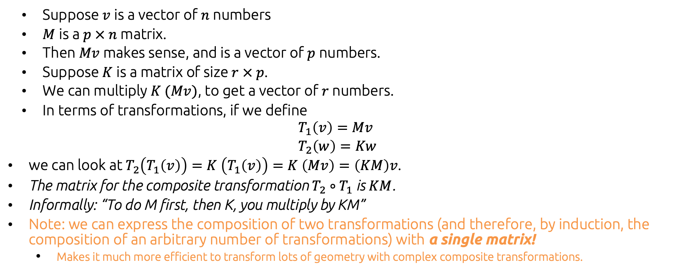
Composition of Transformations
Suppose $v$ is a vector of $n$ numbers
$M$ is a $p × n$ matrix.
Then $Mv$ makes sense, and is a vector of $p$ numbers.
Suppose $K$ is a matrix of size $r × p$.
We can multiply $K (Mv)$, to get a vector of $r$ numbers.
In terms of transformations, if we define
$$T_{1}\left(v\right)=Mv \\ T_{2}\left(w\right)=Kw$$
we can look at $T_{2}\left(T_{1}\left(v\right)\right)=K \left(T_{1}\left(v\right)\right)=K \left(Mv\right)=\left(KM\right)v$.
The matrix for the composite transformation $T_{2}∘T_{1}$is $KM$.
Informally: “To do M first, then K, you multiply by KM”
Note: we can express the composition of two transformations (and therefore, by induction, the composition of an arbitrary number of transformations) with a single matrix!
Makes it much more efficient to transform lots of geometry with complex composite transformations.

Slide 8
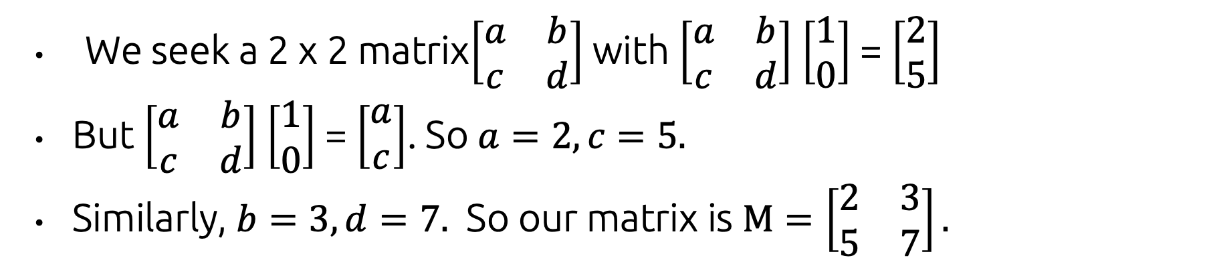
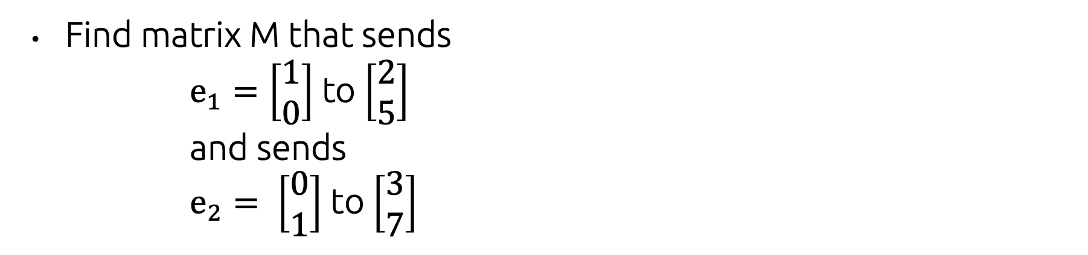
Building transformations using basis vectors
Find matrix M that sends $e_{1}=\left[\begin{aligned}1 \\ 0\end{aligned}\right]$ to $\left[\begin{aligned}2 \\ 5\end{aligned}\right]$ and sends $e_{2}= \left[\begin{aligned}0 \\ 1\end{aligned}\right]$ to $\left[\begin{aligned}3 \\ 7\end{aligned}\right]$
We seek a 2 x 2 matrix$\left[\begin{matrix}a & b \\ c & d\end{matrix}\right]$ with $\left[\begin{matrix}a & b \\ c & d\end{matrix}\right]$ $\left[\begin{aligned}1 \\ 0\end{aligned}\right]$ = $\left[\begin{aligned}2 \\ 5\end{aligned}\right]$
But $\left[\begin{matrix}a & b \\ c & d\end{matrix}\right]$ $\left[\begin{aligned}1 \\ 0\end{aligned}\right]$ = $\left[\begin{aligned}a \\ c\end{aligned}\right]$. So $a=2, c=5.$
Similarly, $b=3, d=7.$ So our matrix is $M=\left[\begin{matrix}2 & 3 \\ 5 & 7\end{matrix}\right].$

Slide 9
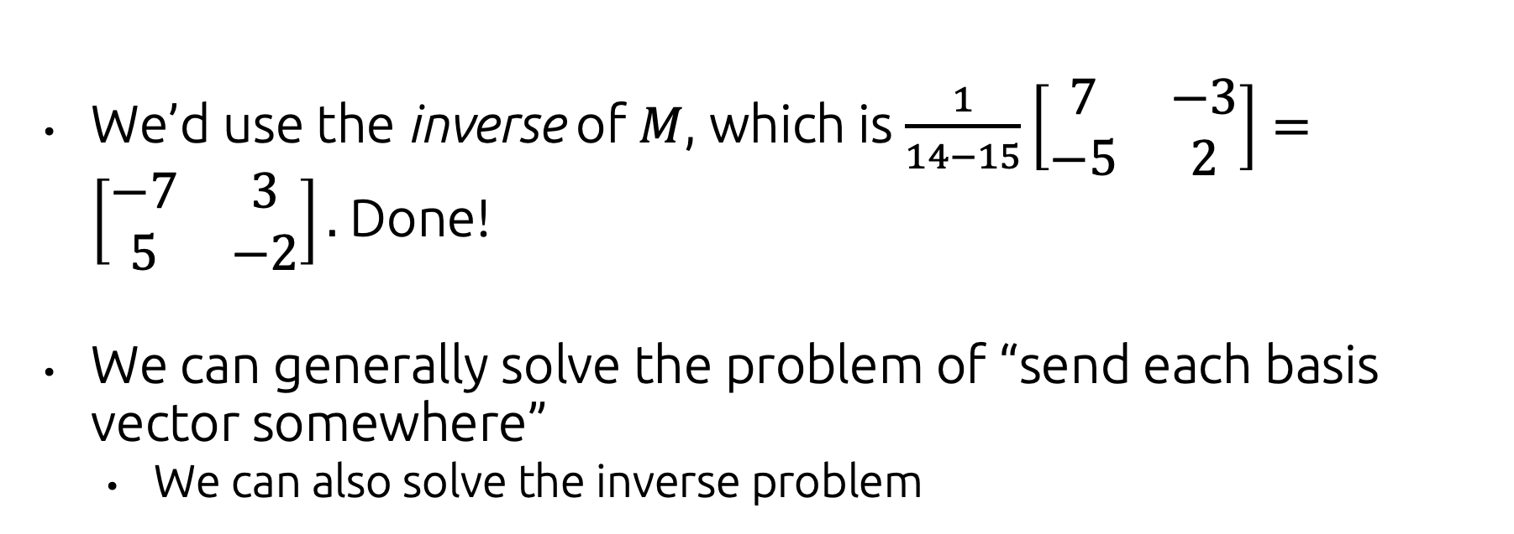

Building transformations using basis vectors
What if we wanted to send $\left[\begin{aligned}2 \\ 5\end{aligned}\right]$ to $\left[\begin{aligned}1 \\ 0\end{aligned}\right]$, and $\left[\begin{aligned}3 \\ 7\end{aligned}\right]$ to $\left[\begin{aligned}0 \\ 1\end{aligned}\right]$?
We’d use the inverse of $M$, which is $\frac{1}{14−15}\left[\begin{matrix}7 & −3 \\ −5 & 2\end{matrix}\right]=\left[\begin{matrix}−7 & 3 \\ 5 & −2\end{matrix}\right].$ Done!
We can generally solve the problem of “send each basis vector somewhere”
We can also solve the inverse problem

Slide 10
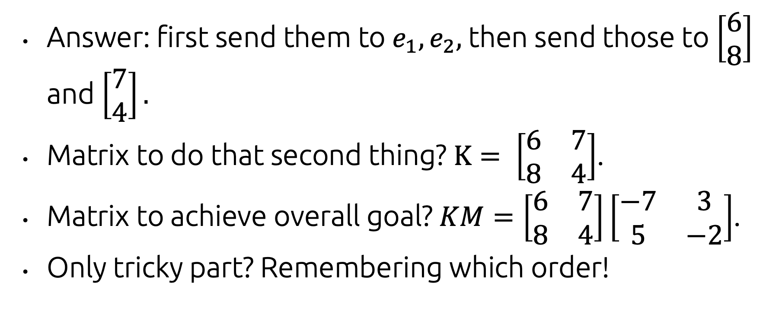

Building transformations using basis vectors
How could we send $\left[\begin{aligned}2 \\ 5\end{aligned}\right]$ to $\left[\begin{aligned}6 \\ 8\end{aligned}\right]$, and $\left[\begin{aligned}3 \\ 7\end{aligned}\right]$ to $\left[\begin{aligned}7 \\ 4\end{aligned}\right]?$
Answer: first send them to $e_{1}, e_{2},$then send those to $\left[\begin{aligned}6 \\ 8\end{aligned}\right]$ and $\left[\begin{aligned}7 \\ 4\end{aligned}\right].$
Matrix to do that second thing? $K= \left[\begin{matrix}6 & 7 \\ 8 & 4\end{matrix}\right]$.
Matrix to achieve overall goal? $KM=\left[\begin{matrix}6 & 7 \\ 8 & 4\end{matrix}\right]\left[\begin{matrix}−7 & 3 \\ 5 & −2\end{matrix}\right]$.
Only tricky part? Remembering which order!

Slide 11
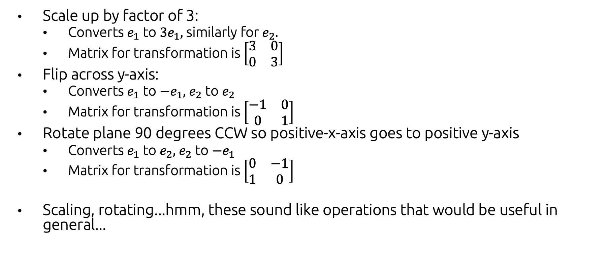
Concrete examples of transformations
Scale up by factor of 3:
Converts $e_{1}$ to $3e_{1},$ similarly for $e_{2}.$
Matrix for transformation is $\left[\begin{matrix}3 & 0 \\ 0 & 3\end{matrix}\right]$
Flip across y-axis:
Converts $e_{1}$ to $−e_{1},$ $e_{2}$ to $e_{2}$
Matrix for transformation is $\left[\begin{matrix}−1 & 0 \\ 0 & 1\end{matrix}\right]$
Rotate plane 90 degrees CCW so positive-x-axis goes to positive y-axis
Converts $e_{1}$ to $e_{2},$ $e_{2}$ to ${−e}_{1}$
Matrix for transformation is $\left[\begin{matrix}0 & −1 \\ 1 & 0\end{matrix}\right]$
Scaling, rotating...hmm, these sound like operations that would be useful in general...

Slide 12
2D Transformations

Slide 13
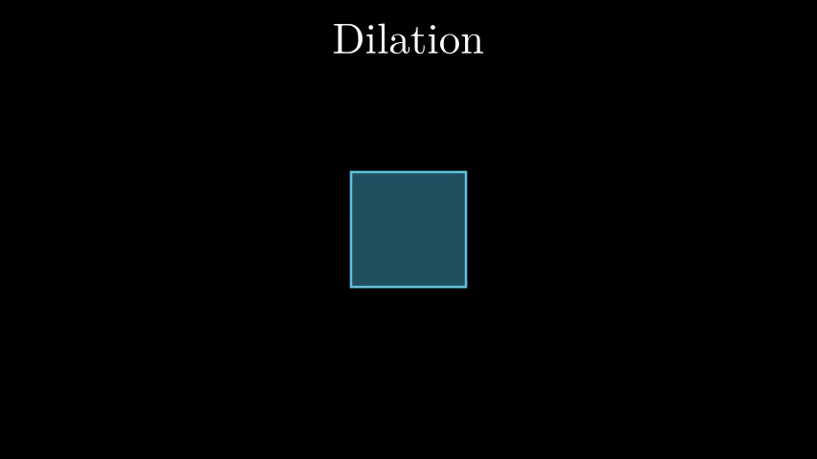
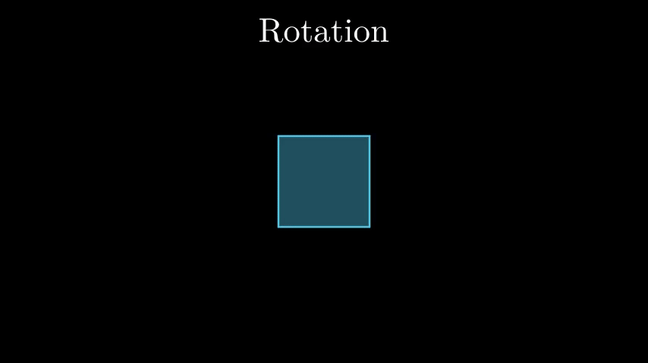

Basic types of Transformations
Scale
Rotate
Translate
https://towardsdatascience.com/understanding-transformations-in-computer-vision-b001f49a9e61

Slide 14
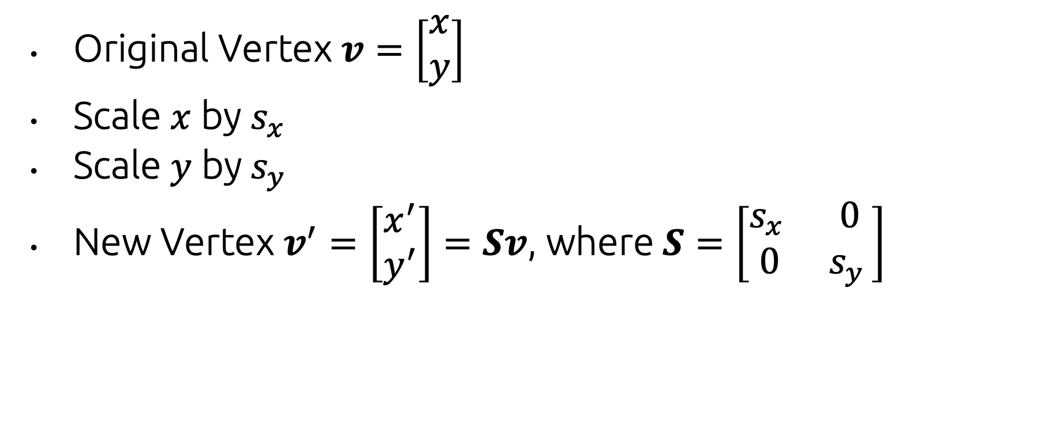
Matrix Formula for Scale
Original Vertex $v=\left[\begin{matrix}x \\ y\end{matrix}\right]$
Scale $x$ by $s_{x}$
Scale $y$ by$s_{y}$
New Vertex $v^{′}=\left[\begin{matrix}x^{′} \\ y^{′}\end{matrix}\right]=Sv$, where $S=\left[\begin{matrix}s_{x } & 0 \\ 0 & s_{y }\end{matrix}\right]$

Slide 15
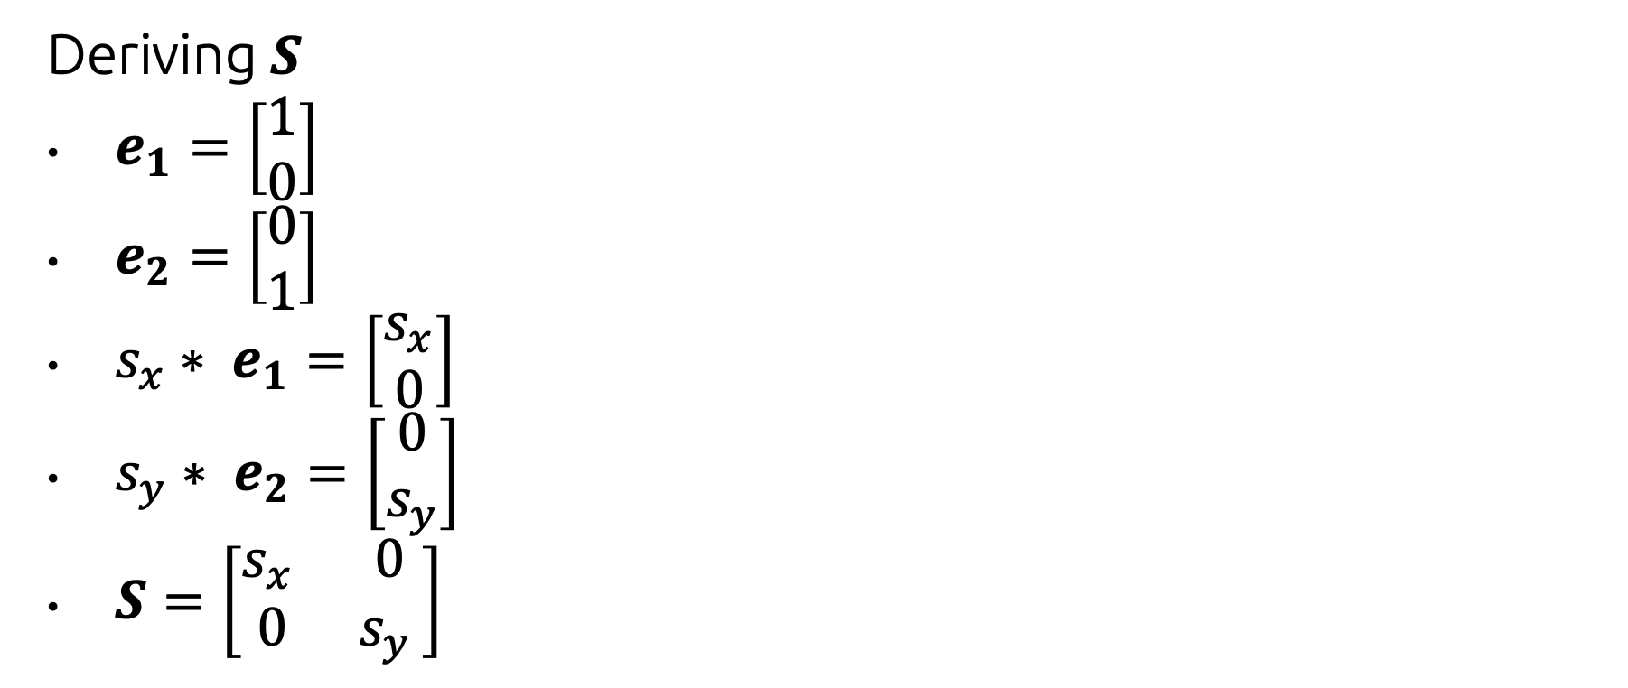
Matrix Formula for Scale
Deriving $S$
$e_{1}=\left[\begin{matrix}1 \\ 0\end{matrix}\right]$
$e_{2}=\left[\begin{matrix}0 \\ 1\end{matrix}\right]$
$s_{x}∗ e_{1}=\left[\begin{matrix}s_{x} \\ 0\end{matrix}\right]$
$s_{y}∗ e_{2}=\left[\begin{matrix}0 \\ s_{y}\end{matrix}\right]$
$S=\left[\begin{matrix}s_{x } & 0 \\ 0 & s_{y }\end{matrix}\right]$

Slide 16
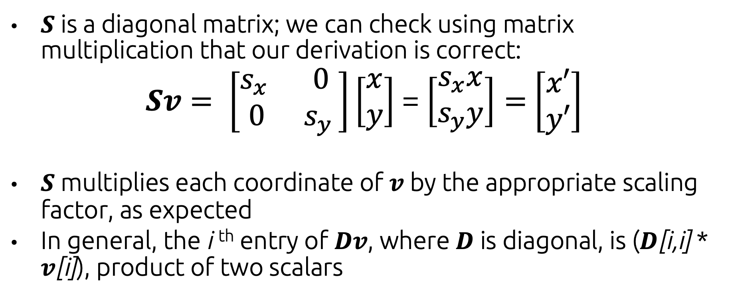
Matrix Formula for Scale
$S$ is a diagonal matrix; we can check using matrix multiplication that our derivation is correct:
$Sv= \left[\begin{matrix}s_{x } & 0 \\ 0 & s_{y }\end{matrix}\right]\left[\begin{matrix}x \\ y\end{matrix}\right]$ = $\left[\begin{matrix}s_{x}x \\ s_{y}y\end{matrix}\right]=$ $\left[\begin{matrix}x′ \\ y′\end{matrix}\right]$
$S$ multiplies each coordinate of $v$ by the appropriate scaling factor, as expected
In general, the i ^{th} entry of $Dv$, where $D$ is diagonal, is ($D$[i,i] * $v$[i]), product of two scalars

Slide 17
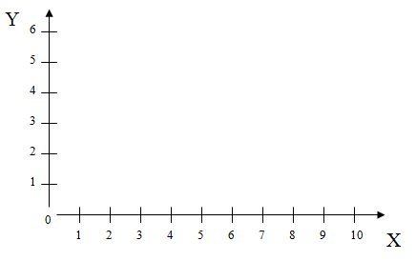
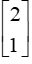
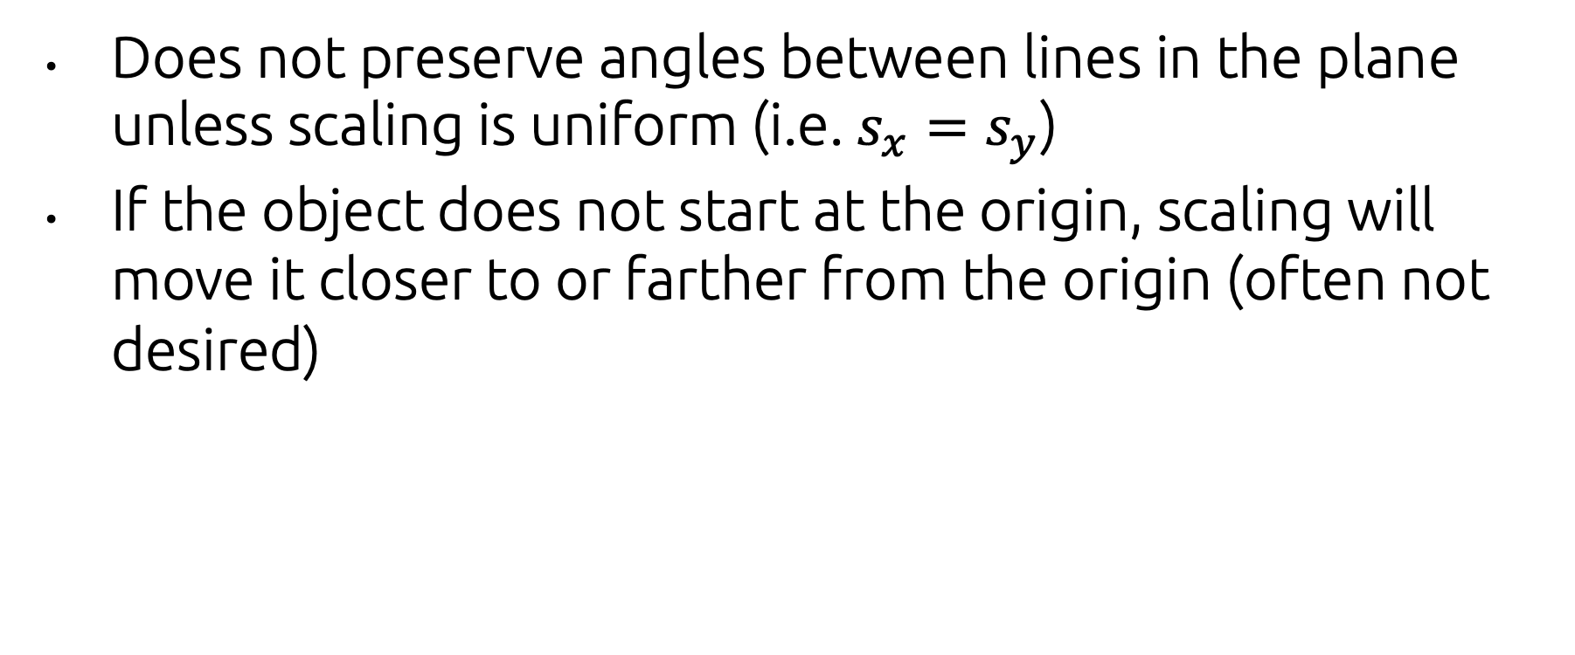
Matrix Formula for Scale
Does not preserve angles between lines in the plane unless scaling is uniform (i.e. $s_{x}=s_{y}$)
If the object does not start at the origin, scaling will move it closer to or farther from the origin (often not desired)
Side effect: House shifts position relative to origin

Slide 18
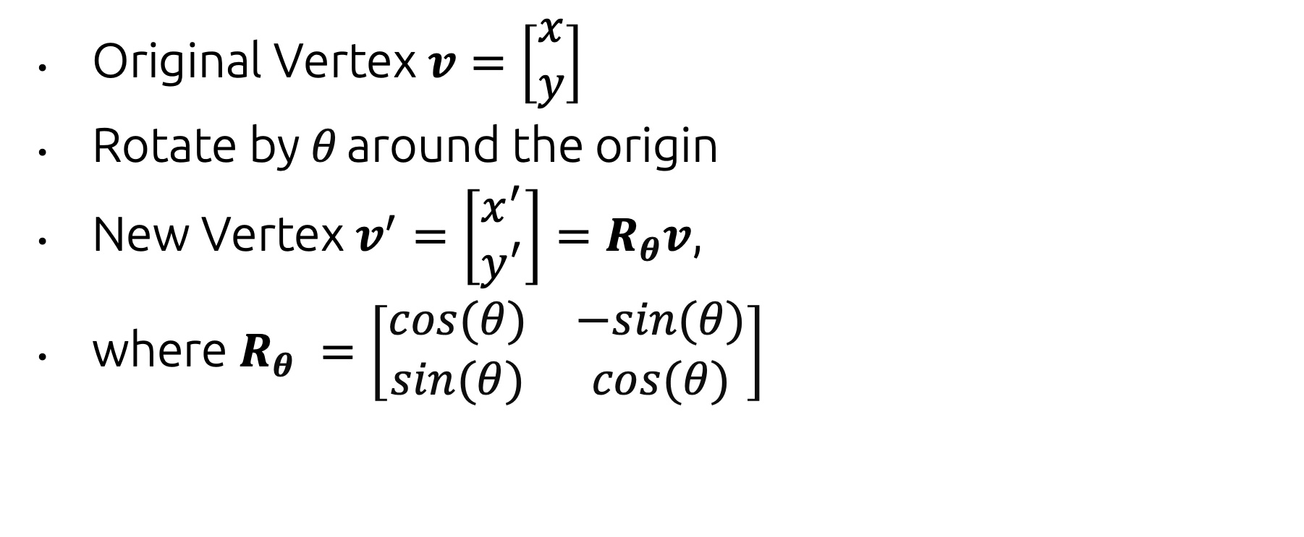
Matrix Formula for Rotate
Original Vertex $v=\left[\begin{matrix}x \\ y\end{matrix}\right]$
Rotate by $θ$ around the origin
New Vertex $v^{′}=\left[\begin{matrix}x^{′} \\ y^{′}\end{matrix}\right]=R_{θ}v$,
where $R_{θ} =\left[\begin{matrix}cos⁡(θ) & −sin(θ) \\ sin⁡(θ) & cos⁡(θ)\end{matrix}\right]$

Slide 19
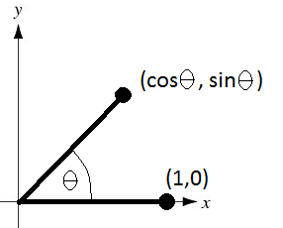
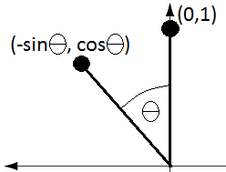
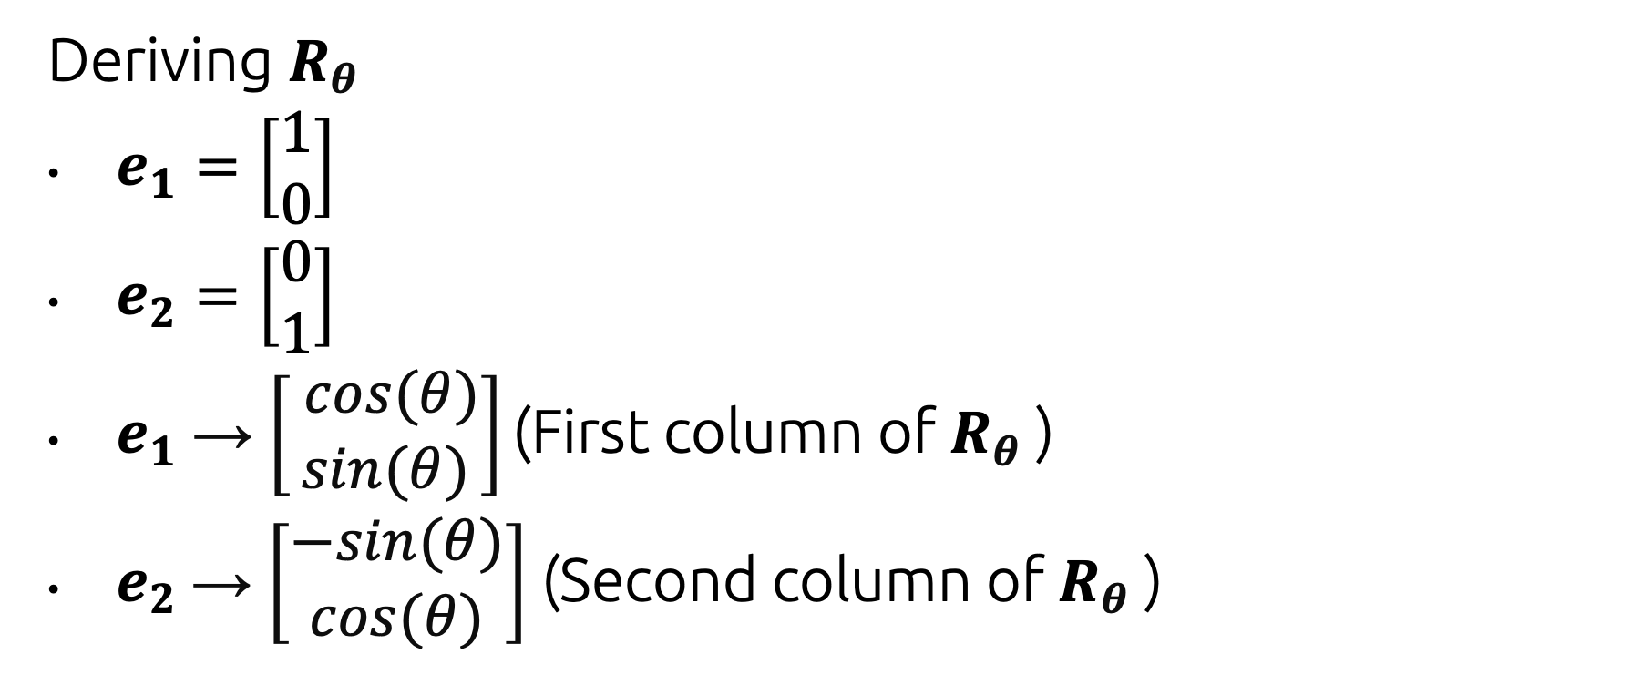
Matrix Formula for Rotate
Deriving $R_{θ}$
$e_{1}=\left[\begin{matrix}1 \\ 0\end{matrix}\right]$
$e_{2}=\left[\begin{matrix}0 \\ 1\end{matrix}\right]$
$e_{1}$ → $\left[\begin{aligned} cos⁡(θ) \\ sin⁡(θ)\end{aligned}\right]$ (First column of $R_{θ}$ )
$e_{2}$→ $\left[\begin{aligned}−sin⁡(θ) \\ cos⁡(θ)\end{aligned}\right]$ (Second column of $R_{θ}$ )
Proof: https://matthew-brett.github.io/teaching/rotation_2d.html

Slide 20
Matrix Formula for Rotate
Preserves lengths in objects and angles between parts of objects (rigid-body rotation)
This is rotation about the origin, not around the center of the object. For objects not centered at the origin, such a rotation will “translate” the center of the object!

Slide 21
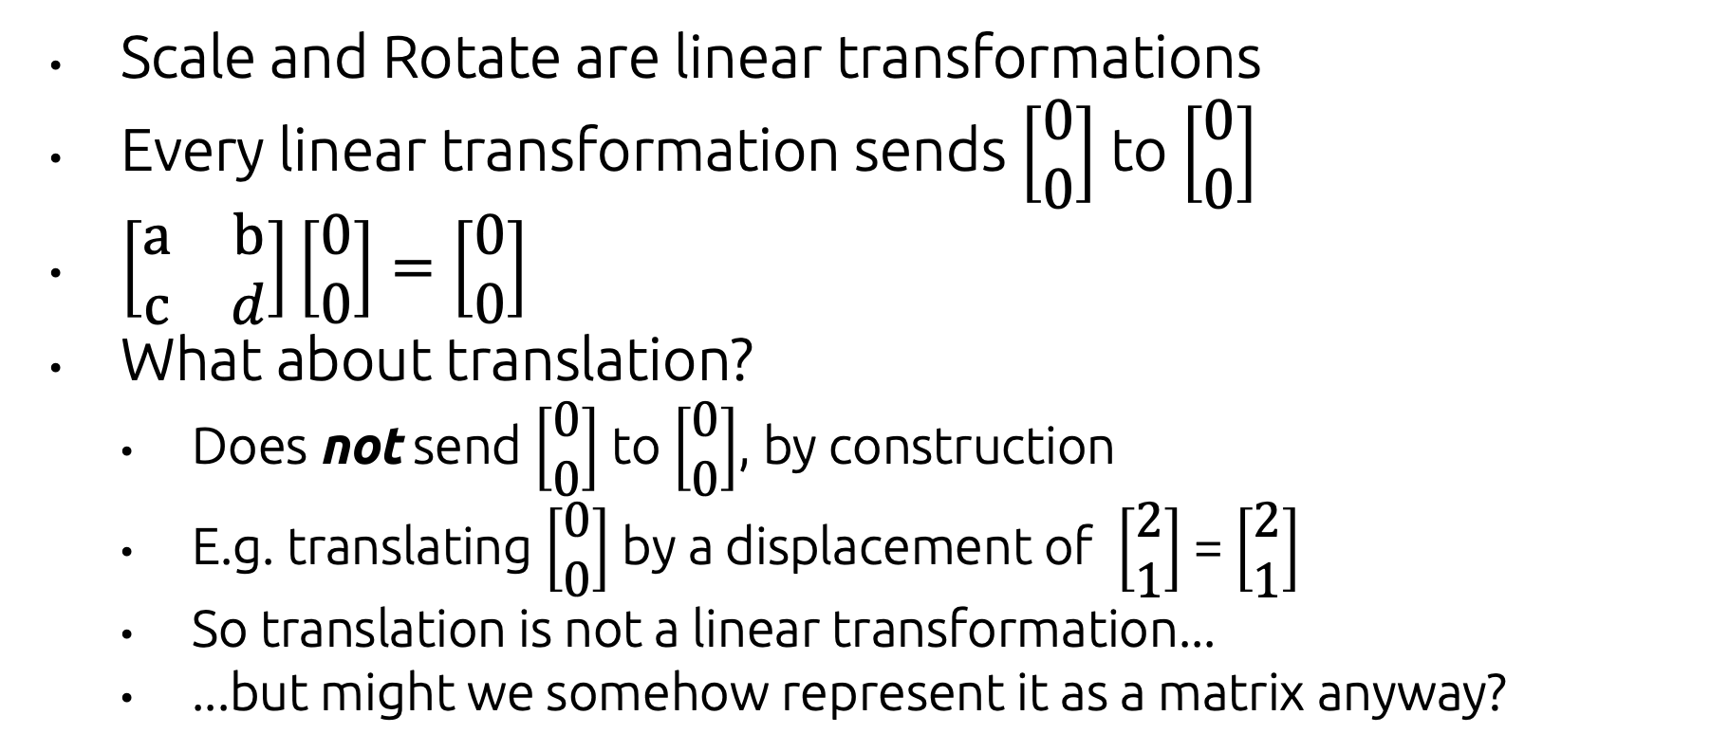
Linear → Affine transformations
Scale and Rotate are linear transformations
Every linear transformation sends $\left[\begin{matrix}0 \\ 0\end{matrix}\right]$ to $\left[\begin{matrix}0 \\ 0\end{matrix}\right]$
$\left[\begin{matrix}a & b \\ c & d\end{matrix}\right]\left[\begin{aligned}0 \\ 0\end{aligned}\right]=\left[\begin{aligned}0 \\ 0\end{aligned}\right]$
What about translation?
Does not send $\left[\begin{matrix}0 \\ 0\end{matrix}\right]$ to $\left[\begin{matrix}0 \\ 0\end{matrix}\right]$, by construction
E.g. translating $\left[\begin{matrix}0 \\ 0\end{matrix}\right]$ by a displacement of $\left[\begin{matrix}2 \\ 1\end{matrix}\right]$ = $\left[\begin{matrix}2 \\ 1\end{matrix}\right]$
So translation is not a linear transformation...
...but might we somehow represent it as a matrix anyway?

Slide 22
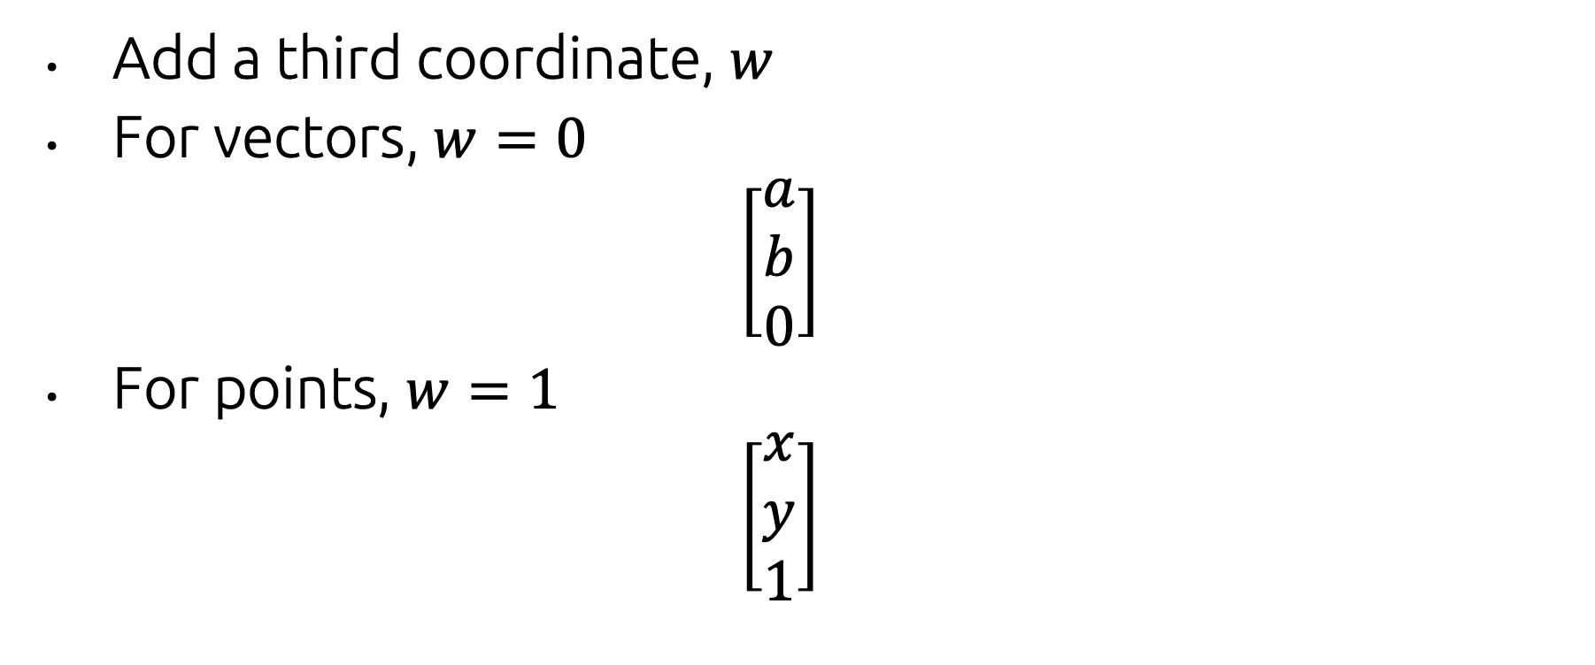
Homogeneous Coordinates
Add a third coordinate, $w$
For vectors, $w=0$
$$\left[\begin{matrix}a \\ b \\ 0\end{matrix}\right]$$
For points, $w=1$
$$\left[\begin{matrix}x \\ y \\ 1\end{matrix}\right]$$

Slide 23
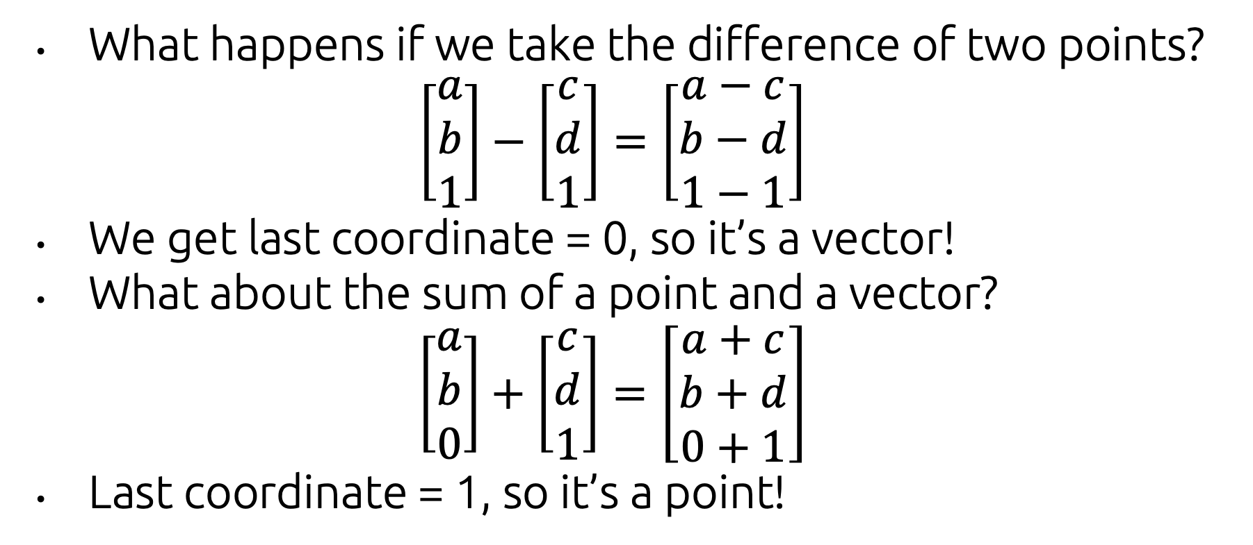
Homogeneous Coordinates
What happens if we take the difference of two points?
$$\left[\begin{matrix}a \\ b \\ 1\end{matrix}\right]−\left[\begin{matrix}c \\ d \\ 1\end{matrix}\right]=\left[\begin{matrix}a−c \\ b−d \\ 1−1\end{matrix}\right]$$
We get last coordinate = 0, so it’s a vector!
What about the sum of a point and a vector?
$$\left[\begin{matrix}a \\ b \\ 0\end{matrix}\right]+\left[\begin{matrix}c \\ d \\ 1\end{matrix}\right]=\left[\begin{matrix}a+c \\ b+d \\ 0+1\end{matrix}\right]$$
Last coordinate = 1, so it’s a point!

Slide 24
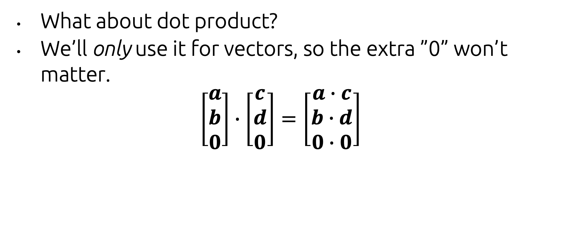
Homogeneous Coordinates
What about dot product?
We’ll only use it for vectors, so the extra ”0” won’t matter.
$$\left[\begin{matrix}a \\ b \\ 0\end{matrix}\right]∙\left[\begin{matrix}c \\ d \\ 0\end{matrix}\right]=\left[\begin{matrix}a∙c \\ b∙d \\ 0∙0\end{matrix}\right]$$

Slide 25
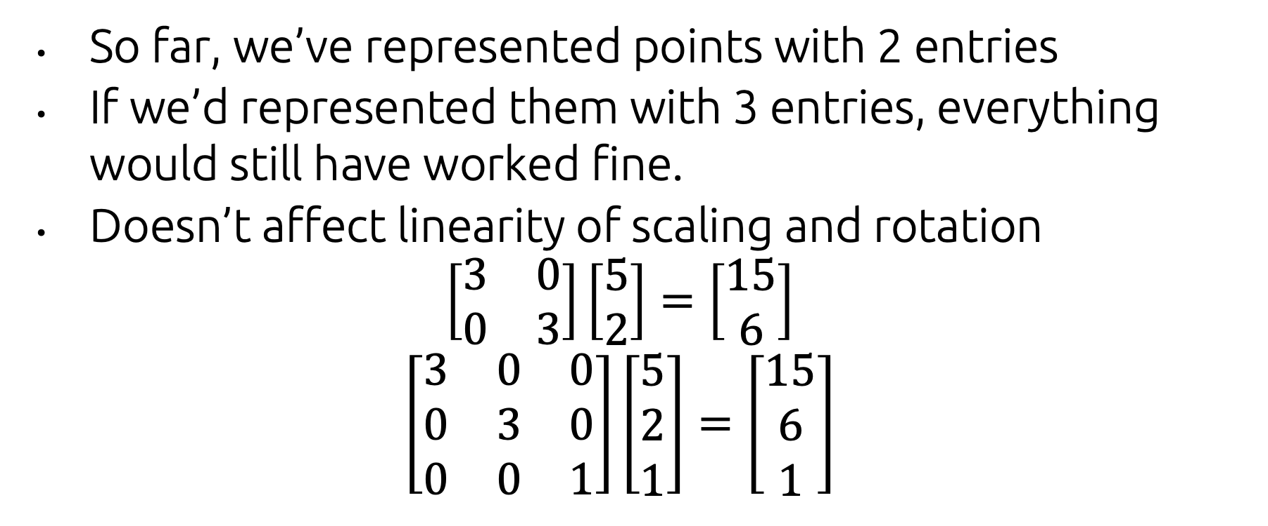
Homogeneous Coordinates
So far, we’ve represented points with 2 entries
If we’d represented them with 3 entries, everything would still have worked fine.
Doesn’t affect linearity of scaling and rotation
$$\left[\begin{matrix}3 & 0 \\ 0 & 3\end{matrix}\right]\left[\begin{matrix}5 \\ 2\end{matrix}\right]=\left[\begin{matrix}15 \\ 6\end{matrix}\right]$$
$$\left[\begin{matrix}3 & 0 & 0 \\ 0 & 3 & 0 \\ 0 & 0 & 1\end{matrix}\right]\left[\begin{matrix}5 \\ 2 \\ 1\end{matrix}\right]=\left[\begin{matrix}15 \\ 6 \\ 1\end{matrix}\right]$$

Slide 26
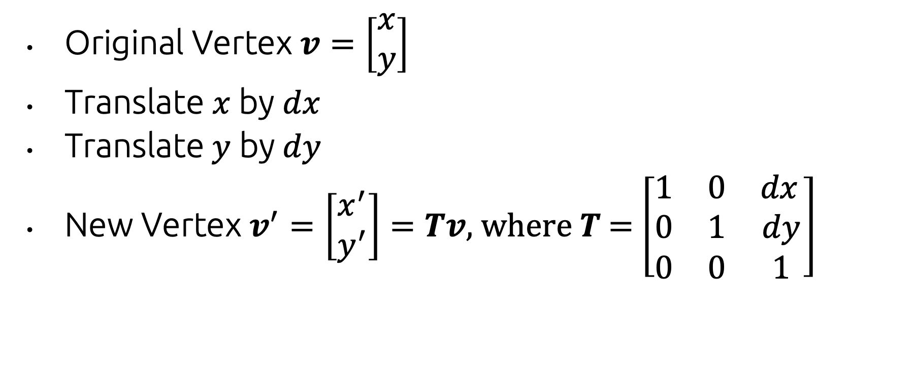
Matrix Formula for Translation
Original Vertex $v=\left[\begin{matrix}x \\ y\end{matrix}\right]$
Translate $x$ by $dx$
Translate $y$ by$dy$
New Vertex $v^{′}=\left[\begin{matrix}x^{′} \\ y^{′}\end{matrix}\right]=Tv$, where $T$ = $\left[\begin{matrix}1 & 0 & dx \\ 0 & 1 & dy \\ 0 & 0 & 1\end{matrix}\right]$

Slide 27
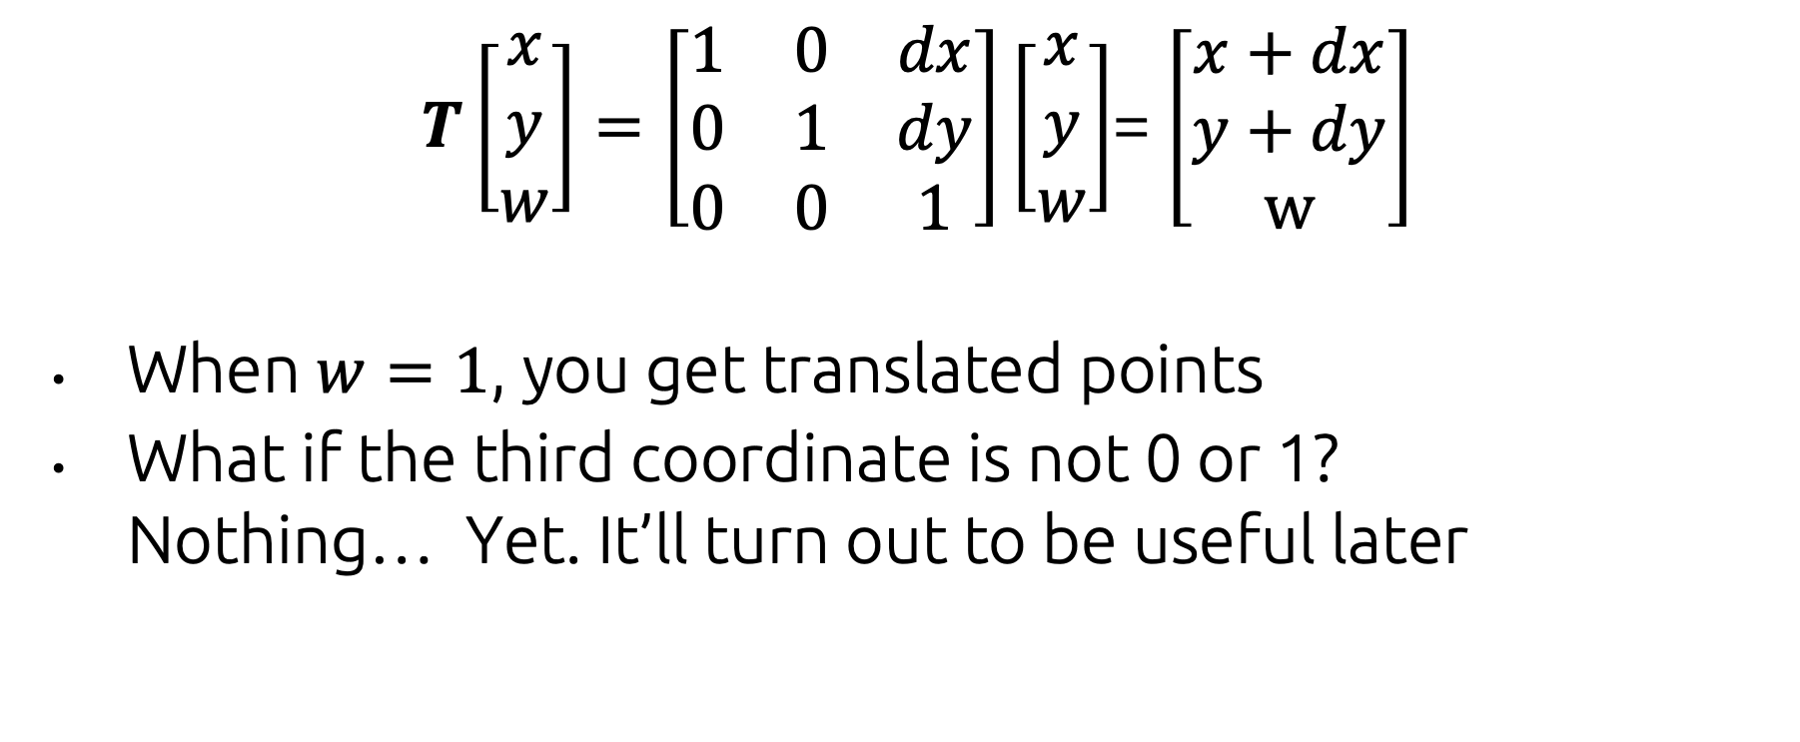
Matrix Formula for Translation
$T\left[\begin{aligned}x \\ y \\ w\end{aligned}\right]=\left[\begin{matrix}1 & 0 & dx \\ 0 & 1 & dy \\ 0 & 0 & 1\end{matrix}\right]\left[\begin{aligned}x \\ y \\ w\end{aligned}\right]$= $\left[\begin{aligned}x+dx \\ y+dy \\ w\end{aligned}\right]$
When $w=1$, you get translated points
What if the third coordinate is not 0 or 1? Nothing… Yet. It’ll turn out to be useful later

Slide 28
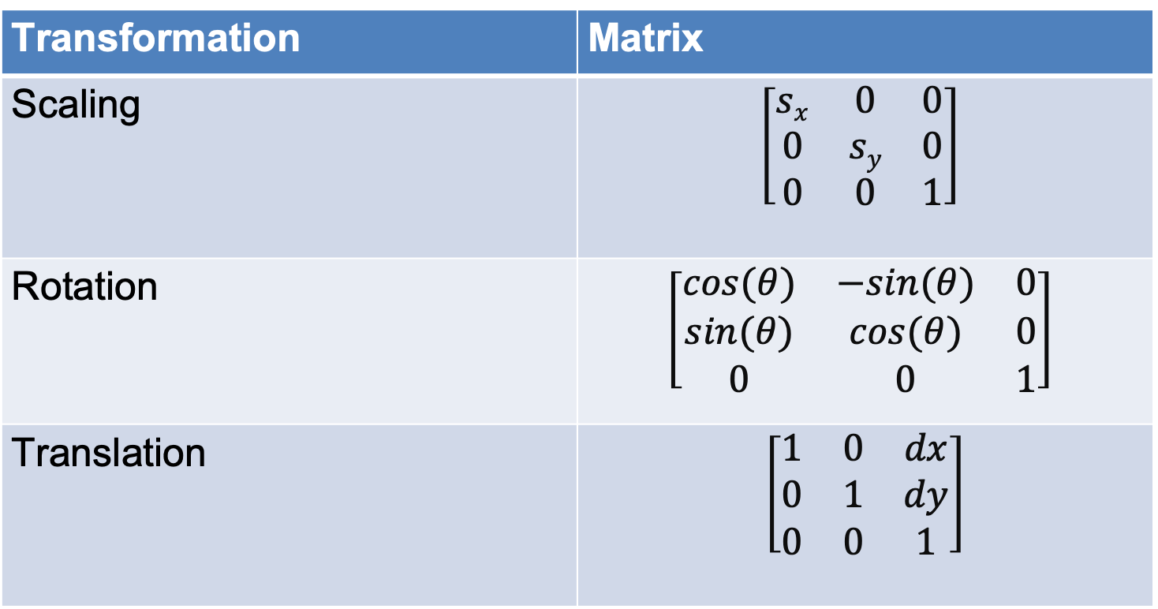
Summary: Matrix Formulas
Transformation | Matrix
Scaling | $$\left[\begin{matrix}sx & 0 & 0 \\ 0 & sy & 0 \\ 0 & 0 & 1\end{matrix}\right]$$
Rotation | $$\left[\begin{matrix}cos⁡(θ) & −sin⁡(θ) & 0 \\ sin(θ) & cos⁡(θ) & 0 \\ 0 & 0 & 1\end{matrix}\right]$$
Translation | $$\left[\begin{matrix}1 & 0 & dx \\ 0 & 1 & dy \\ 0 & 0 & 1\end{matrix}\right]$$

Slide 29
Inverses
When we want to undo a transformation, we’ll need to find the matrix’s inverse.
Thanks to homogeneous coordinates, all our building blocks are invertible!

Slide 30
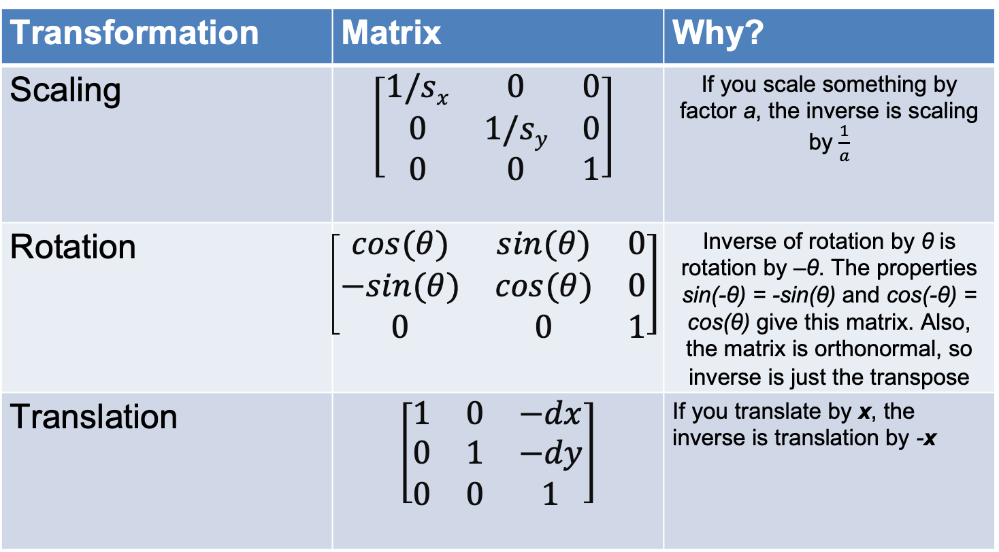
Inverses
Transformation | Matrix | Why?
Scaling | $$\left[\begin{matrix}1/sx & 0 & 0 \\ 0 & 1/sy & 0 \\ 0 & 0 & 1\end{matrix}\right]$$ | If you scale something by factor a, the inverse is scaling by $\frac{1}{a}$
Rotation | $$\left[\begin{matrix}cos⁡(θ) & sin⁡(θ) & 0 \\ −sin(θ) & cos⁡(θ) & 0 \\ 0 & 0 & 1\end{matrix}\right]$$ | Inverse of rotation by θ is rotation by –θ. The properties sin(-θ) = -sin(θ) and cos(-θ) = cos(θ) give this matrix. Also, the matrix is orthonormal, so inverse is just the transpose
Translation | $$\left[\begin{matrix}1 & 0 & −dx \\ 0 & 1 & −dy \\ 0 & 0 & 1\end{matrix}\right]$$ | If you translate by x, the inverse is translation by -x

Slide 31
Composing Transformations
Translation, rotation, and scaling are great building blocks to form a more complex transformation
For example, TRSv, which scales a point, then rotates it, then translates it
Note that we apply the matrices in sequence right to left.

Slide 32
Composing Transformations
Important: order matters! Matrix multiplication is NOT commutative
6
Rotate by 45º,
then translate
by x = 8, y = 0
Y
6
Translate by
x = 8, y = 0, then
rotate by 45º
5
5
4
4
3
3
2
2
1
1
0
1
2
3
4
5
6
7
8
9
10
0
1
2
3
4
5
6
7
8
9
10
X

Slide 33
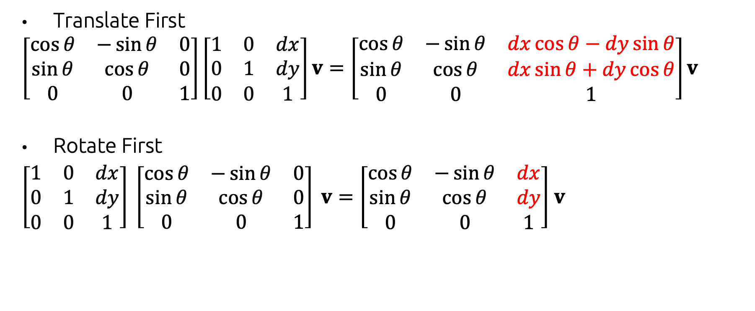
Composing Transformations
Translate First
$$\left[\begin{matrix}\cos{θ} & −\sin{θ} & 0 \\ \sin{θ} & \cos{θ} & 0 \\ 0 & 0 & 1\end{matrix}\right]\left[\begin{matrix}1 & 0 & dx \\ 0 & 1 & dy \\ 0 & 0 & 1\end{matrix}\right]v=\left[\begin{matrix}\cos{θ} & −\sin{θ} & dx\cos{θ}−dy\sin{θ} \\ \sin{θ} & \cos{θ} & dx\sin{θ}+dy\cos{θ} \\ 0 & 0 & 1\end{matrix}\right]v$$
Rotate First
$\left[\begin{matrix}1 & 0 & dx \\ 0 & 1 & dy \\ 0 & 0 & 1\end{matrix}\right] \left[\begin{matrix}\cos{θ} & −\sin{θ} & 0 \\ \sin{θ} & \cos{θ} & 0 \\ 0 & 0 & 1\end{matrix}\right] v=\left[\begin{matrix}\cos{θ} & −\sin{θ} & dx \\ \sin{θ} & \cos{θ} & dy \\ 0 & 0 & 1\end{matrix}\right]$ $v$

Slide 34
Inverse of a Composition
What is the inverse of a sequence of transformations?
(M₁M₂…M_{n})⁻¹ = M_{n}⁻¹M_{n-1}⁻¹…M₁⁻¹
Inverse of a sequence of transformations is the composition of the inverses of each transformation in reverse order!

Slide 35
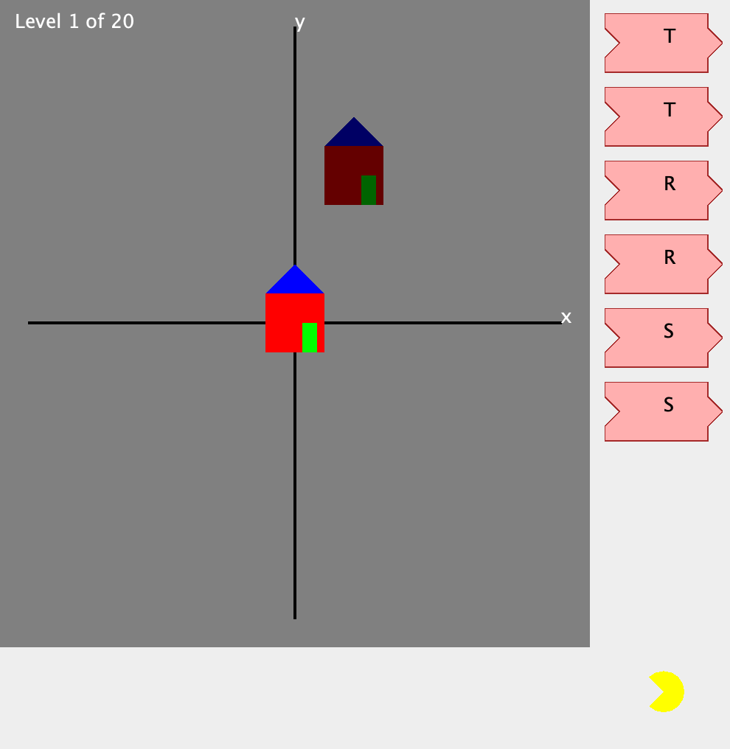
Transformation Game!
Try it yourself! Link to .jar here. You’ll need a Java runtime, then run java –jar transformation_game.jar

Slide 36
3D Transformations

Slide 37
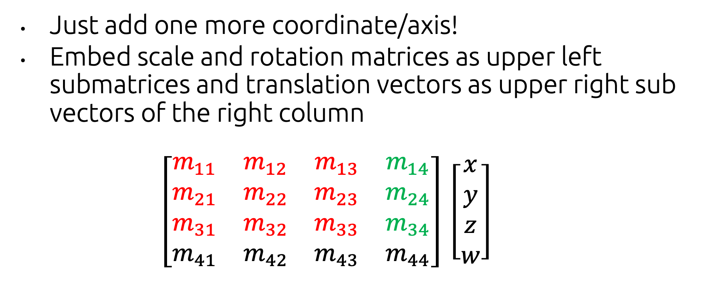
3D Transformations
Just add one more coordinate/axis!
Embed scale and rotation matrices as upper left submatrices and translation vectors as upper right sub vectors of the right column
$\left[\begin{matrix}m_{11} & m_{12} & m_{13} & m_{14} \\ m_{21} & m_{22} & m_{23} & m_{24} \\ m_{31} & m_{32} & m_{33} & m_{34} \\ m_{41} & m_{42} & m_{43} & m_{44}\end{matrix}\right] \left[\begin{matrix}x \\ y \\ z \\ w\end{matrix}\right]$

Slide 38
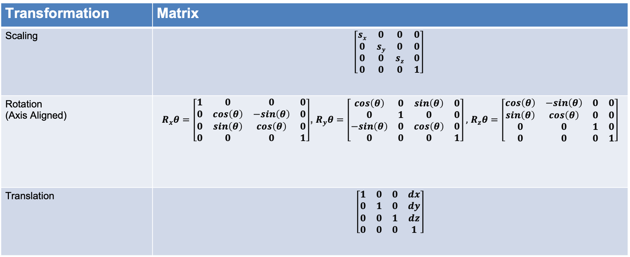
3D Matrix Formulas
Transformation | Matrix
Scaling | $$\left[\begin{matrix}sx & 0 & 0 & 0 \\ 0 & sy & 0 & 0 \\ 0 & 0 & sz & 0 \\ 0 & 0 & 0 & 1\end{matrix}\right]$$
Rotation (Axis Aligned) | $R_{x}θ=\left[\begin{matrix}1 & 0 & 0 & 0 \\ 0 & cos\left(θ\right) & −sin\left(θ\right) & 0 \\ 0 & sin\left(θ\right) & cos\left(θ\right) & 0 \\ 0 & 0 & 0 & 1\end{matrix}\right]$, $R_{y}θ=\left[\begin{matrix}cos\left(θ\right) & 0 & sin\left(θ\right) & 0 \\ 0 & 1 & 0 & 0 \\ −sin\left(θ\right) & 0 & cos\left(θ\right) & 0 \\ 0 & 0 & 0 & 1\end{matrix}\right],$ $R_{z}θ=\left[\begin{matrix}cos\left(θ\right) & −sin\left(θ\right) & 0 & 0 \\ sin\left(θ\right) & cos\left(θ\right) & 0 & 0 \\ 0 & 0 & 1 & 0 \\ 0 & 0 & 0 & 1\end{matrix}\right]$
Translation | $$\left[\begin{matrix}1 & 0 & 0 & dx \\ 0 & 1 & 0 & dy \\ 0 & 0 & 1 & dz \\ 0 & 0 & 0 & 1\end{matrix}\right]$$

Slide 39

Inverse
Transformation | Matrix
Scaling | $$\left[\begin{matrix}1/sx & 0 & 0 & 0 \\ 0 & 1/sy & 0 & 0 \\ 0 & 0 & 1/sz & 0 \\ 0 & 0 & 0 & 1\end{matrix}\right]$$
Rotation (Axis Aligned) | $R_{x}θ=\left[\begin{matrix}1 & 0 & 0 & 0 \\ 0 & cos\left(θ\right) & sin\left(θ\right) & 0 \\ 0 & −sin\left(θ\right) & cos\left(θ\right) & 0 \\ 0 & 0 & 0 & 1\end{matrix}\right]$, $R_{y}θ=\left[\begin{matrix}cos\left(θ\right) & 0 & −sin\left(θ\right) & 0 \\ 0 & 1 & 0 & 0 \\ sin\left(θ\right) & 0 & cos\left(θ\right) & 0 \\ 0 & 0 & 0 & 1\end{matrix}\right],$ $R_{z}θ=\left[\begin{matrix}cos\left(θ\right) & sin\left(θ\right) & 0 & 0 \\ −sin\left(θ\right) & cos\left(θ\right) & 0 & 0 \\ 0 & 0 & 1 & 0 \\ 0 & 0 & 0 & 1\end{matrix}\right]$
Translation | $$\left[\begin{matrix}1 & 0 & 0 & −dx \\ 0 & 1 & 0 & −dy \\ 0 & 0 & 1 & −dz \\ 0 & 0 & 0 & 1\end{matrix}\right]$$

Slide 40
3D Transformation Matrices in GLM
# include <glm/glm.hpp>
//construct a 4D vector
glm::vec4 originalVector = glm::vec4(10.0f, 10.0f, 10.0f, 1.0f);
//construct a matrix for translate, scale, and rotate
glm::mat4 translateMatrix = glm::translate(0.5f, 0.5f, 0.5f);
glm::mat4 scaleMatrix = glm::scale(2.0f, 2.0f, 2.0f);
glm::mat4 rotationMatrix = glm::rotate(3.14f, 1.0f, 0.0f, 0.f);
//composition and apply
glm::mat4 transformMatrix = translateMatrix * rotationMatrix * scaleMatrix;
glm::vec4 transformedVector = transformMatrix * originalVector;

Slide 41
3D Transformation Matrices in GLM
# include <glm/glm.hpp>
//construct a 4D vector
glm::vec4 originalVector = glm::vec4(10.0f, 10.0f, 10.0f, 1.0f);
//construct a matrix for translate, scale, and rotate
glm::mat4 translateMatrix = glm::translate(0.5f, 0.5f, 0.5f);
glm::mat4 scaleMatrix = glm::scale(2.0f, 2.0f, 2.0f);
glm::mat4 rotationMatrix = glm::rotate(3.14f, 1.0f, 0.0f, 0.f);
//composition and apply
glm::mat4 transformMatrix = translateMatrix * rotationMatrix * scaleMatrix;
glm::vec4 transformedVector = transformMatrix * originalVector;
Rotation angle
Rotation axis

Slide 42
Rotation about arbitrary axes

Slide 43
Non-Axis Aligned 3D Rotation
In 3D, you can rotate about an arbitrary axis! How to achieve this?
Euler Angles
Axis Angle
Quaternions
https://create3dcharacters.com/maya-animation-graph-editor-fundamentals/

Slide 44
Non-Axis Aligned 3D Rotation
In 3D, you can rotate about an arbitrary axis! How to achieve this?
Euler Angles
Axis Angle
Quaternions
https://create3dcharacters.com/maya-animation-graph-editor-fundamentals/

Slide 45
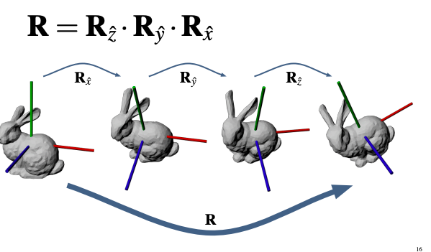
Euler Angles
Composition of 3 different angles of counter-clockwise rotation around 3 axes (Pitch, Yaw, Roll)
x axis in the yz plane by ψ
y axis in the zx plane by θ
z axis in the xy plane by ϕ

Slide 46
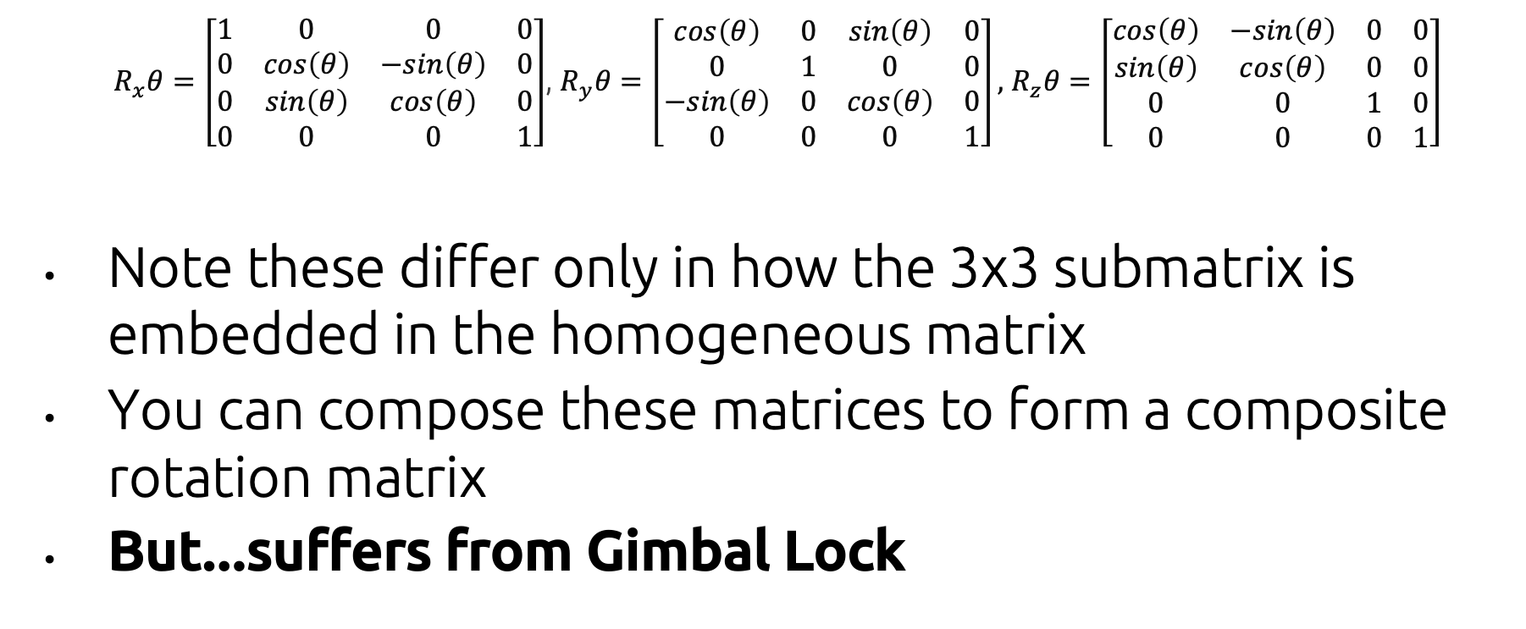
Euler Angles
$R_{x}θ=\left[\begin{matrix}1 & 0 & 0 & 0 \\ 0 & cos\left(θ\right) & −sin\left(θ\right) & 0 \\ 0 & sin\left(θ\right) & cos\left(θ\right) & 0 \\ 0 & 0 & 0 & 1\end{matrix}\right]$, $R_{y}θ=\left[\begin{matrix}cos\left(θ\right) & 0 & sin\left(θ\right) & 0 \\ 0 & 1 & 0 & 0 \\ −sin\left(θ\right) & 0 & cos\left(θ\right) & 0 \\ 0 & 0 & 0 & 1\end{matrix}\right],$ $R_{z}θ=\left[\begin{matrix}cos\left(θ\right) & −sin\left(θ\right) & 0 & 0 \\ sin\left(θ\right) & cos\left(θ\right) & 0 & 0 \\ 0 & 0 & 1 & 0 \\ 0 & 0 & 0 & 1\end{matrix}\right]$
Note these differ only in how the 3x3 submatrix is embedded in the homogeneous matrix
You can compose these matrices to form a composite rotation matrix
But...suffers from Gimbal Lock

Slide 47
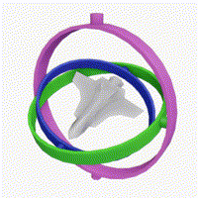
Gimbal Lock
Gimbal lock is the loss of (at least) one degree of freedom in three-gimbal mechanism
The animation below shows a particularly bad example where all three gimbals perform the same rotation.
https://en.wikipedia.org/wiki/Gimbal_lock
Normal
Gimbal Lock

Slide 48
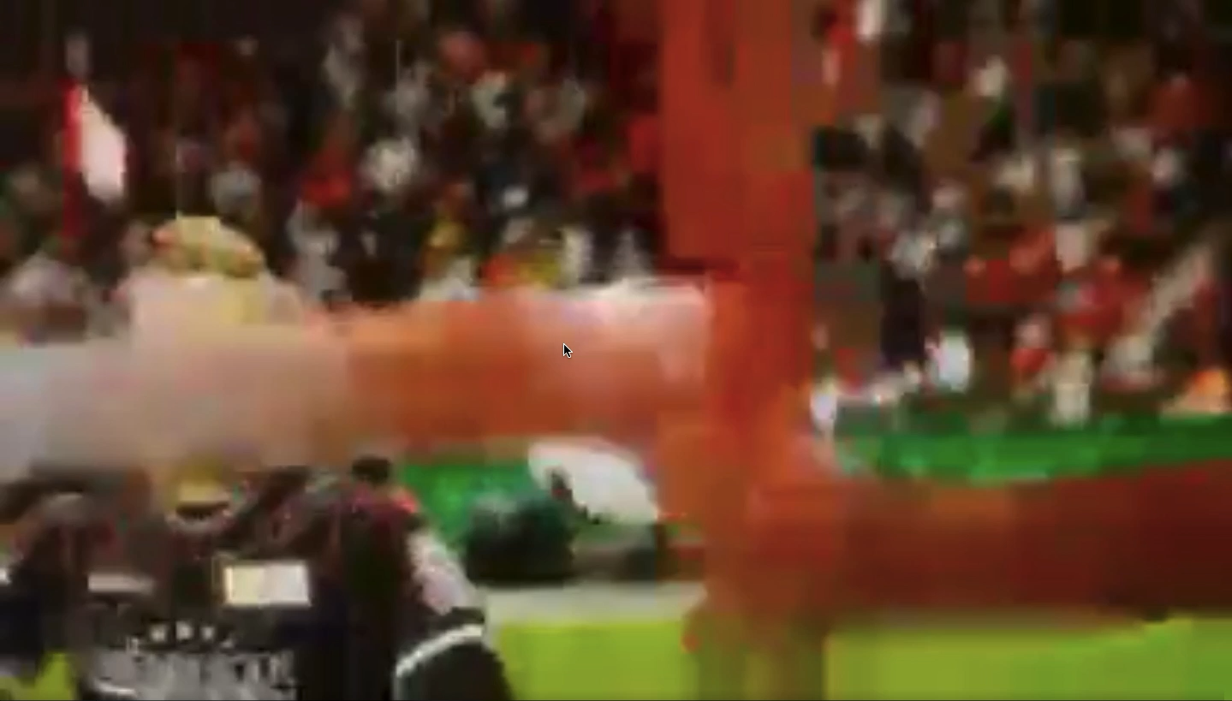
Gimbal Lock
Why this matters for computer graphics
Interpolation between rotations can look arbitrarily weird
https://www.reddit.com/r/FIFA/comments/9gms3n/most_realistic_graphics_ever_in_fifa_history/

Slide 49
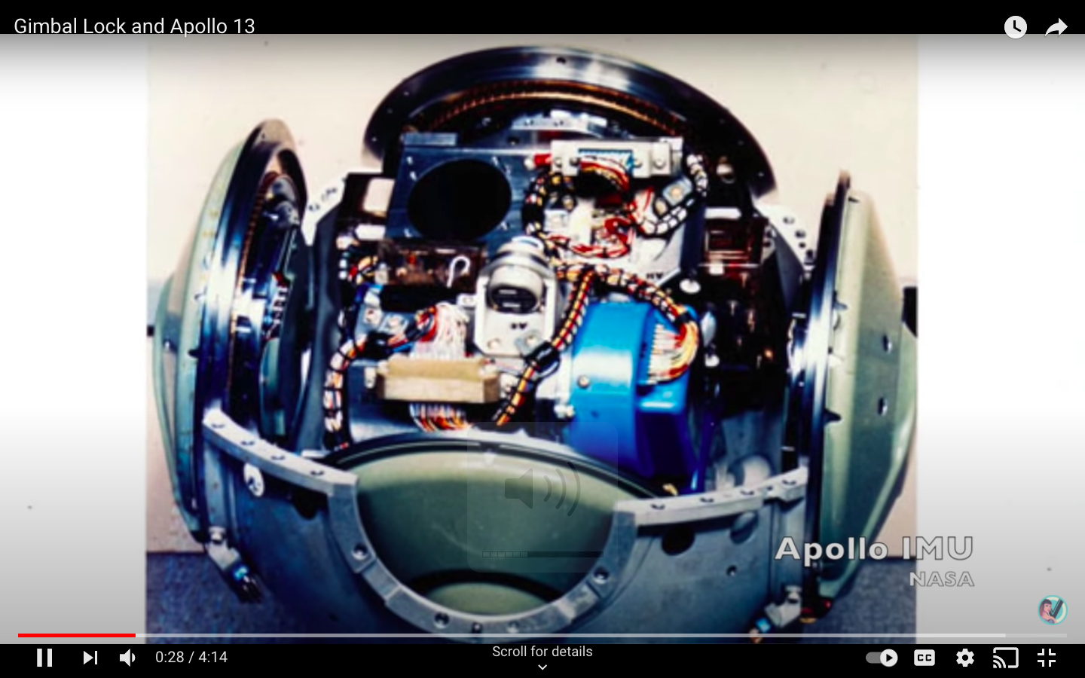
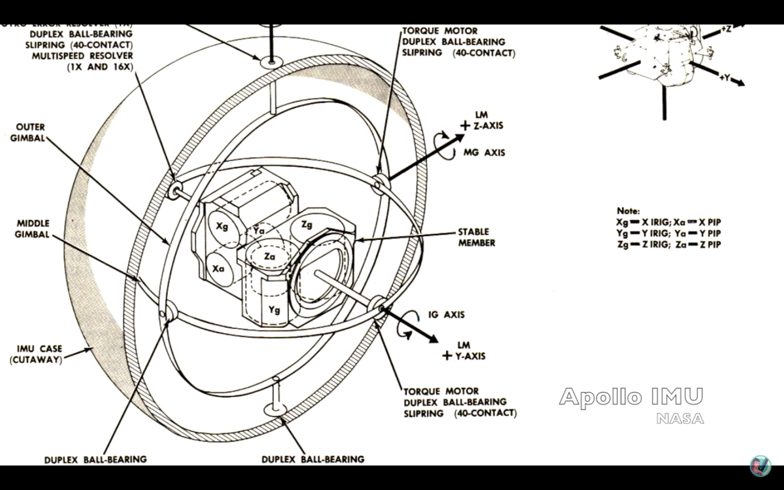
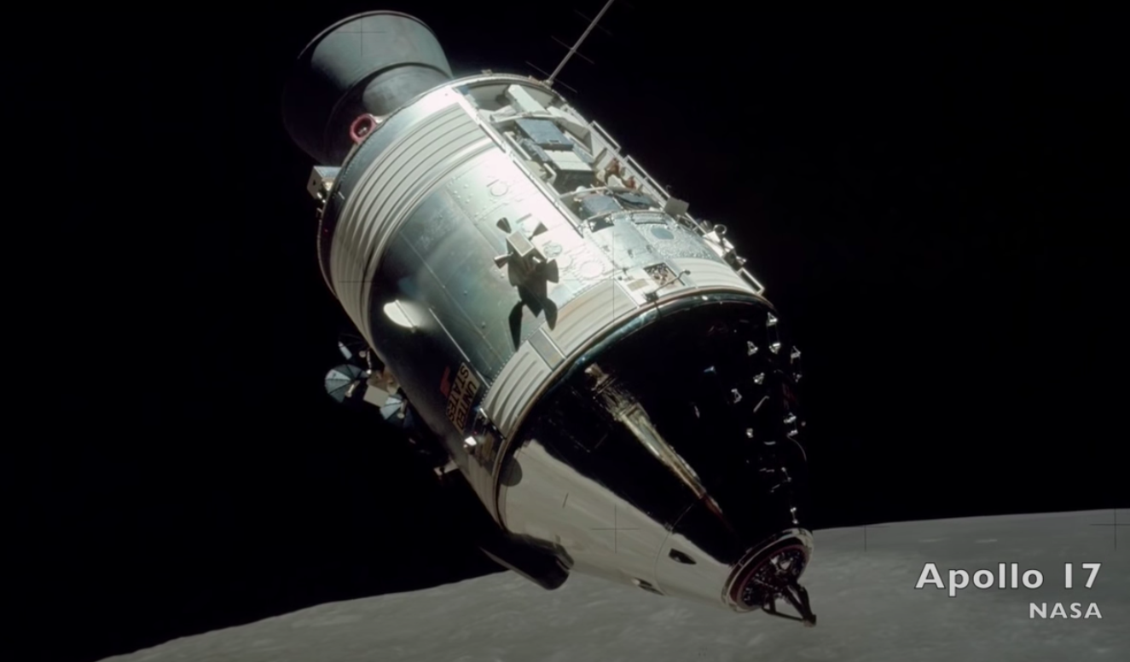
Gimbal Lock
Gimbal Lock and Apollo 13
Used an Inertial measurement unit (IMU), a device that measures the orientation of the spacecraft
Guidance computer was designed to give warning when axes were closed to lining up
"How about sending me a fourth gimbal for Christmas?”– Mike Collins
https://www.youtube.com/watch?v=OmCzZ-D8Wdk

Slide 50
Non-Axis Aligned 3D Rotation
In 3D, you can rotate about an arbitrary axis! How to achieve this?
Euler Angles
Axis Angle
Quaternions
https://create3dcharacters.com/maya-animation-graph-editor-fundamentals/

Slide 51
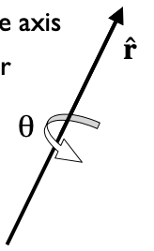
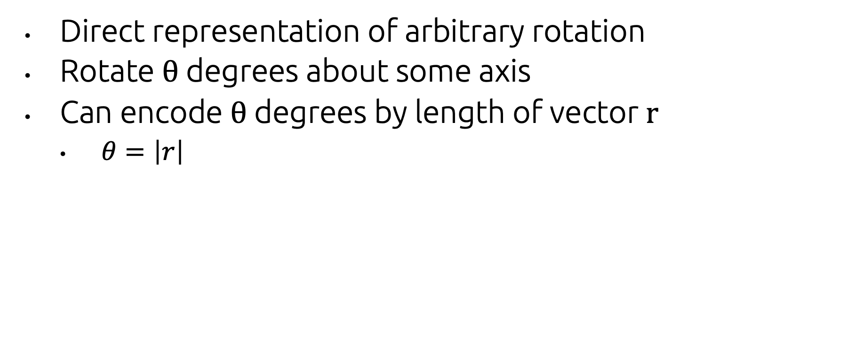
Axis+Angle Representation
Direct representation of arbitrary rotation
Rotate θ degrees about some axis
Can encode θ degrees by length of vector r
$θ=\left|r\right|$
https://inst.eecs.berkeley.edu/~cs184/fa08/lectures/05-3DTRansformations.pdf

Slide 52
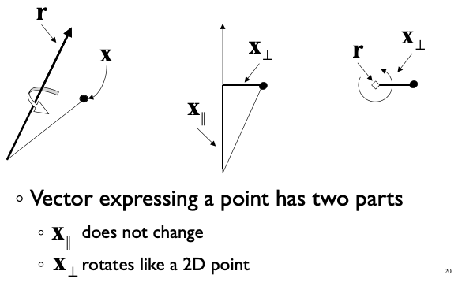
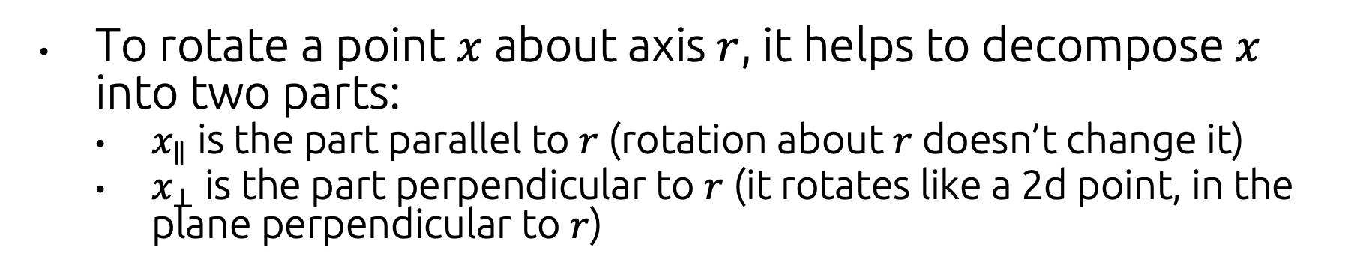
Performing an Axis+Angle Rotation
To rotate a point $x$ about axis $r$, it helps to decompose $x$ into two parts:
$x_{∥}$ is the part parallel to $r$ (rotation about $r$doesn’t change it)
$x_{⊥}$ is the part perpendicular to $r$ (it rotates like a 2d point, in the plane perpendicular to $r$)
https://inst.eecs.berkeley.edu/~cs184/fa08/lectures/05-3DTRansformations.pdf

Slide 53
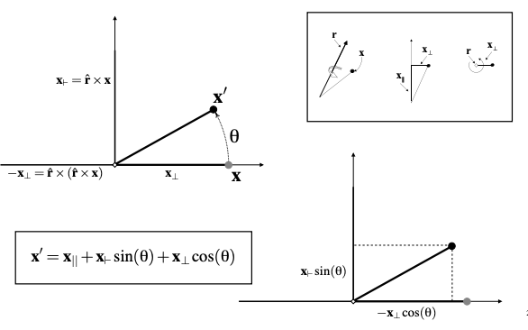
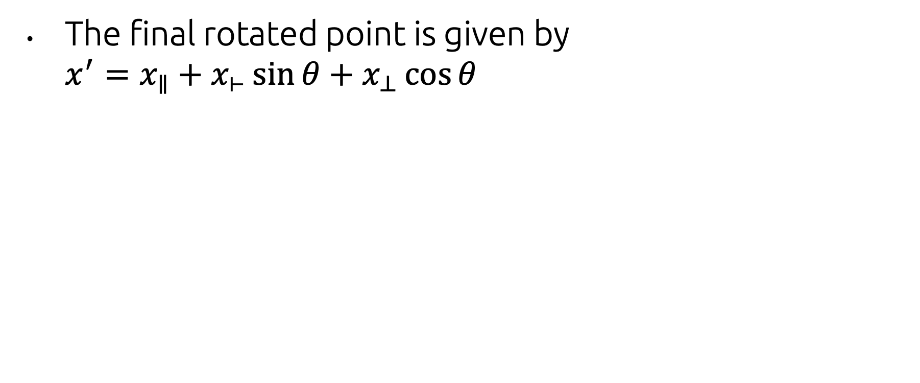
Performing an Axis+Angle Rotation
The final rotated point is given by $x^{′}=x_{∥}+x_{⊢}\sin{θ}+$ $x_{⊥}\cos{θ}$
https://inst.eecs.berkeley.edu/~cs184/fa08/lectures/05-3DTRansformations.pdf

Slide 54
Performing an Axis+Angle Rotation
The final rotated point is given by $x^{′}=x_{∥}+x_{⊢}\sin{θ}+$ $x_{⊥}\cos{θ}$
Rotate as if in 2D
https://inst.eecs.berkeley.edu/~cs184/fa08/lectures/05-3DTRansformations.pdf

Slide 55
Performing an Axis+Angle Rotation
The final rotated point is given by $x^{′}=x_{∥}+x_{⊢}\sin{θ}+$ $x_{⊥}\cos{θ}$
Move back to 3D
Rotate as if in 2D
https://inst.eecs.berkeley.edu/~cs184/fa08/lectures/05-3DTRansformations.pdf

Slide 56
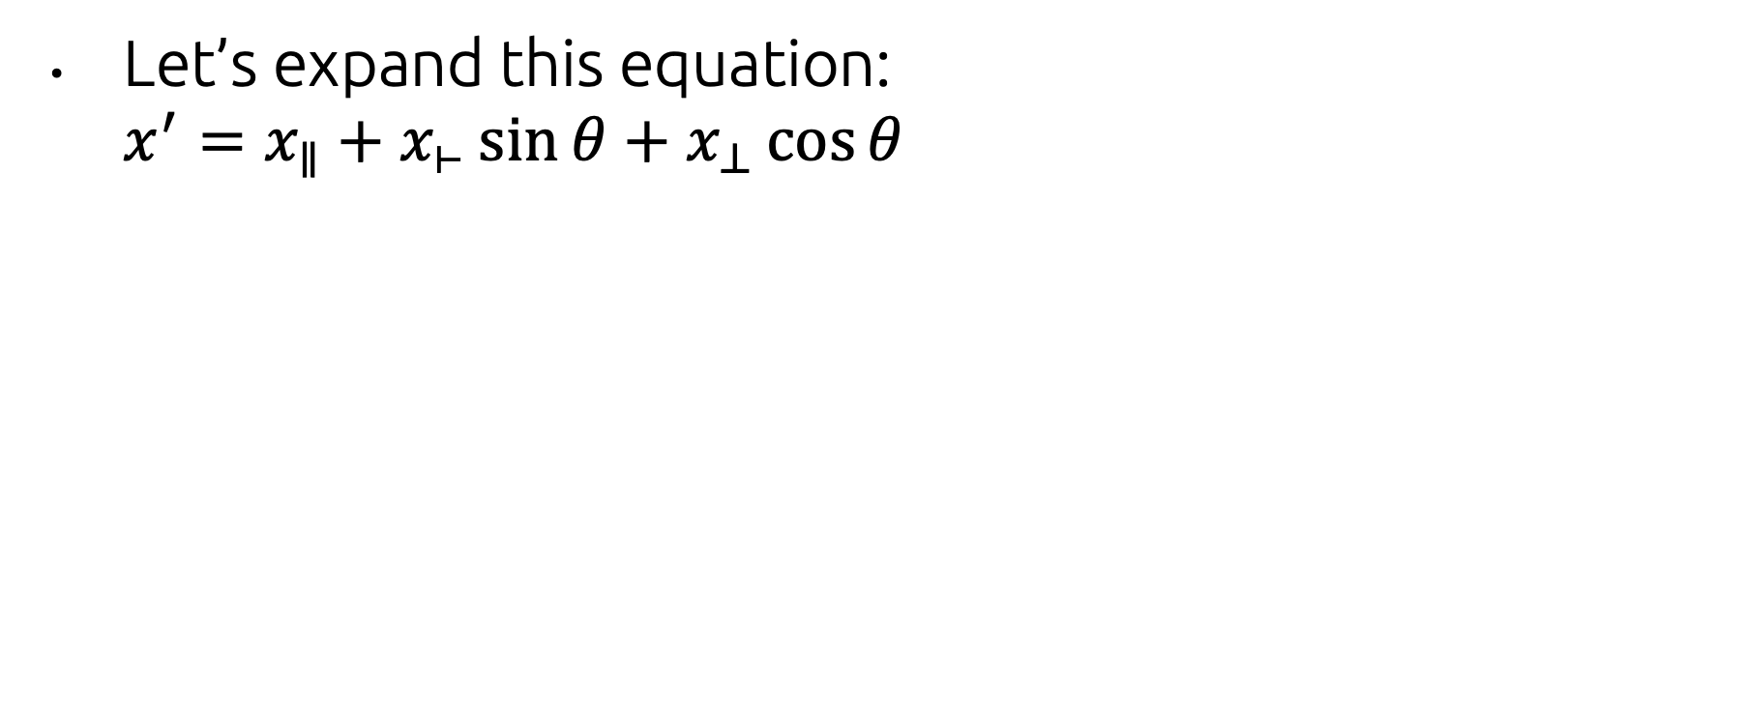
Performing an Axis+Angle Rotation
Let’s expand this equation: $x^{′}=x_{∥}+x_{⊢}\sin{θ}+$ $x_{⊥}\cos{θ}$
https://inst.eecs.berkeley.edu/~cs184/fa08/lectures/05-3DTRansformations.pdf

Slide 57
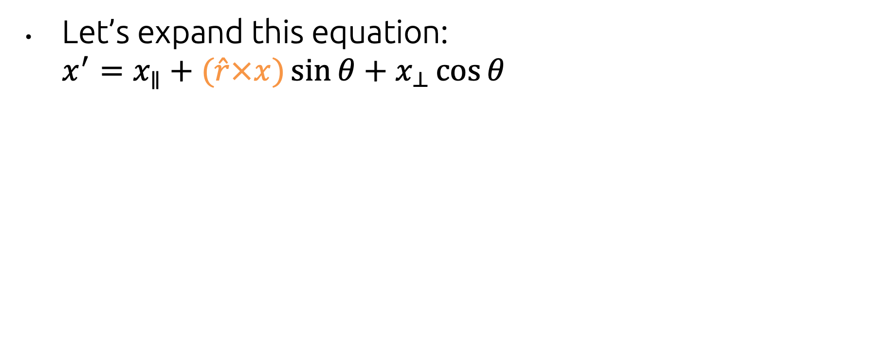

Performing an Axis+Angle Rotation
Let’s expand this equation: $x^{′}=x_{∥}+(\hat{r}×x)\sin{θ}+$ $x_{⊥}\cos{θ}$
$$x_{⊢}$$
https://inst.eecs.berkeley.edu/~cs184/fa08/lectures/05-3DTRansformations.pdf

Slide 58
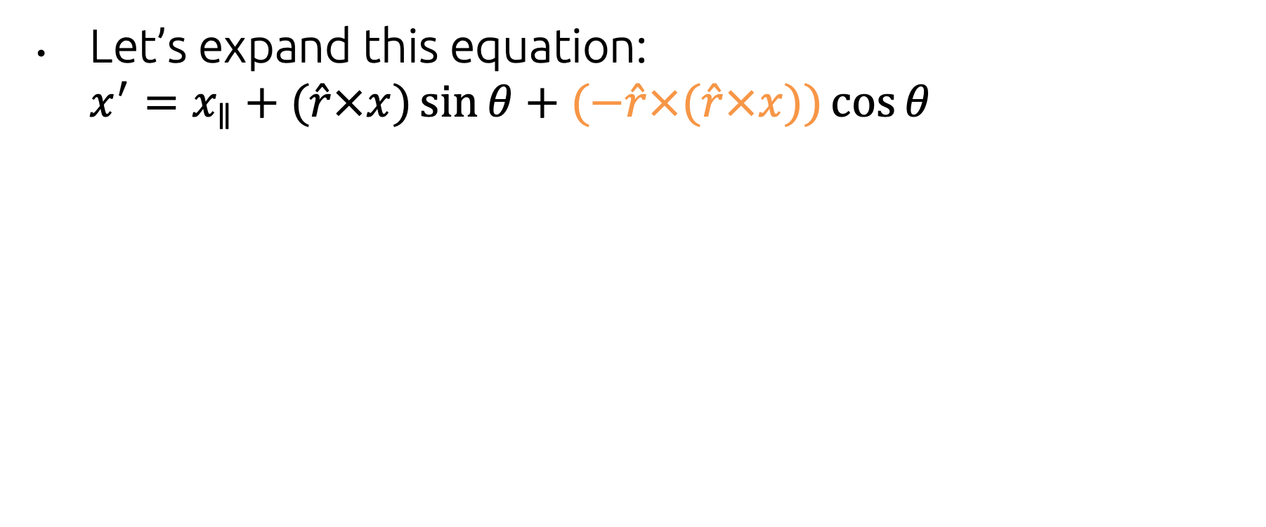

Performing an Axis+Angle Rotation
Let’s expand this equation: $x^{′}=x_{∥}+(\hat{r}×x)\sin{θ}+$ $(−\hat{r}×(\hat{r}×x))\cos{θ}$
$$x_{⊥}$$
https://inst.eecs.berkeley.edu/~cs184/fa08/lectures/05-3DTRansformations.pdf

Slide 59



Performing an Axis+Angle Rotation
Let’s expand this equation: $x^{′}=(\hat{r}(\hat{r}⋅x))+(\hat{r}×x)\sin{θ}+$ $(−\hat{r}×(\hat{r}×x))\cos{θ}$
$$x_{∥}$$
$\hat{r}⋅x$ = the length of the projection of $x$ onto $\hat{r}$
https://inst.eecs.berkeley.edu/~cs184/fa08/lectures/05-3DTRansformations.pdf

Slide 60

Rodrigues’ Formula
This is known as Rodrigues’ rotation formula $x^{′}=\hat{r}(\hat{r}⋅x)+\left(\hat{r}×x\right)\sin{θ}−(\hat{r}×(\hat{r}×x))\cos{θ}$
Ok, great...but this just tells us how to transform a single point. It doesn’t (yet) tell us how to express the transformation as a matrix.

Slide 61

Matrix form of Rodrigues
We can rewrite this: $x^{′}=\hat{r}\left(\hat{r}⋅x\right)+\left(\hat{r}×x\right)\sin{θ}−\left(\hat{r}×\left(\hat{r}×x\right)\right)\cos{θ}$
like this: $x^{′}=\left(\left(\hat{r}{\hat{r}}^{t}\right)+\sin\left(θ\right)\left(\hat{r}×\right)−\cos{θ}\left(\hat{r}×\right)\left(\hat{r}×\right)\right)x$
where: $\left(\hat{r}×\right)=\left[\begin{matrix}0 & −{\hat{r}}_{z} & {\hat{r}}_{y} \\ {\hat{r}}_{z} & 0 & −{\hat{r}}_{x} \\ −{\hat{r}}_{y} & {\hat{r}}_{x} & 0\end{matrix}\right]$
(i.e. the matrix form of the cross product operator—you can expand it yourself and verify that it matches the cross product formula we saw earlier)

Slide 62

Matrix form of Rodrigues
We can rewrite this: $x^{′}=\hat{r}\left(\hat{r}⋅x\right)+\left(\hat{r}×x\right)\sin{θ}−\left(\hat{r}×\left(\hat{r}×x\right)\right)\cos{θ}$
like this: $x^{′}=\left(\left(\hat{r}{\hat{r}}^{t}\right)+\sin\left(θ\right)\left(\hat{r}×\right)−\cos{θ}\left(\hat{r}×\right)\left(\hat{r}×\right)\right)x$
where: $\left(\hat{r}×\right)=\left[\begin{matrix}0 & −{\hat{r}}_{z} & {\hat{r}}_{y} \\ {\hat{r}}_{z} & 0 & −{\hat{r}}_{x} \\ −{\hat{r}}_{y} & {\hat{r}}_{x} & 0\end{matrix}\right]$
(i.e. the matrix form of the cross product operator—you can expand it yourself and verify that it matches the cross product formula we saw earlier)
These terms sum up to make a single matrix!

Slide 63

Matrix form of Rodrigues
Here’s what every entry of the matrix works out to be (where $u=\hat{r}$):
In practice, we can just use glm::rotate ;)

Slide 64
Non-Axis Aligned 3D Rotation
In 3D, you can rotate about an arbitrary axis! How to achieve this?
Euler Angles
Axis Angle
Quaternions
https://create3dcharacters.com/maya-animation-graph-editor-fundamentals/

Slide 65


Remember Complex Numbers?
A complex number has a real part and an imaginary part: $z=x+iy$
These numbers are often plotted on the complex plane (one real axis, one imaginary axis)
Wikipedia

Slide 66

Operations on Complex Numbers
Addition of complex numbers just adds their real & imaginary parts: $\left(x+yi\right)+\left(u+vi\right)=\left(x+u\right)+\left(y+v\right)i$
Multiplication works like polynomial multiplication (remember that $i^{2}=−1$): $\left(x+yi\right)\left(u+vi\right)$ $=xu+xvi+yui+yvi^{2}$ $=\left(xu−yv\right)+\left(xv+yu\right)i$

Slide 67

Complex Multiplication == Rotation
Interestingly, multiplying a complex number by $\cos\left(θ\right)+\sin\left(θ\right)i$ will rotate it by $θ$ in the complex plane:
$$\left(x+yi\right)\left(\cos\left(θ\right)+\sin\left(θ\right)i\right)=\left(\cos\left(θ\right)x −\sin\left(θ\right)y\right)+\left(\sin\left(θ\right)x+\cos\left(θ\right)y\right)i$$
which is equivalent to this in vector form: $\left[\begin{matrix}\cos\left(θ\right)x −\sin\left(θ\right)y \\ \sin\left(θ\right)x+\cos\left(θ\right)y\end{matrix}\right]=\left[\begin{matrix}\cos\left(θ\right) & −\sin\left(θ\right) \\ \sin\left(θ\right) & \cos\left(θ\right)\end{matrix}\right]\left[\begin{matrix}x \\ y\end{matrix}\right]$
which is exactly the formula for a 2D rotation matrix

Slide 68
Complex Rotation...in 3D?
Can we apply this same kind of idea to 3D rotation?
That is, is there a type of ‘complex number’ that exists in 3D (instead of a 2D plane) whose multiplication operation behaves like rotation?
It turns out that the answer is no...
...but you can do this in 4 dimensions.

Slide 69

Warning: weird math ahead
https://store.steampowered.com/app/945680/Here_Be_Dragons/

Slide 70

Quaternions
A quaternion is a 4D object with one real part and three imaginary parts: $q=\left(z_{1},z_{2},z_{3},s\right)=\left(z,s\right)$
$$q=iz_{1}+jz_{2}+kz_{3}+s$$
The three imaginary numbers $i$, $j$, and $k$ obey the following equalities: $$i^{2}=j^{2}=k^{2}=−1$$
$ij=k$ $ji=−k$
$jk=i$ $kj=−i$
$ki=j$ $ik=−j$

Slide 71

Quaternion arithmetic
Addition works component-wise, as with complex numbers.
Multiplication: $p∙q=\left(z_{p},s_{p}\right)\left(z_{q},s_{q}\right)=\left(z_{q}s_{p}+z_{p}s_{q}+z_{p}×z_{q},s_{p}s_{q}−z_{p}∙z_{q}\right)$
Conjugate
$$q^{∗}=(−z,s)$$
Magnitude
$${\left\|q\right\|}^{2}=z∙z+s^{2}=q∙q^{∗}$$

Slide 72

Rotation with Quaternions
We encode a vector to be rotated as a quaternion with the real part set to zero:
$$v=(v,0)$$
We encode a rotation as:
$$r=(\hat{r}\sin{\frac{θ}{2},\cos{\frac{θ}{2}}})$$
We rotate a vector by pre-multiplying by $r$ and post-multiplying by its conjugate:
$$x^{′}=r∙x∙r^{∗}$$
Just as with matrices, rotations can be composed by multiplication:
$$r=r_{1}∙r_{2}$$

Slide 73
Why go through all of this trouble?
Quaternions require less storage/computation than matrices
“Industry-standard” representation for interpolating rotations
They are guaranteed to have no weird intermediate states (like in the FIFA video)
This is because there’s no tumbling with quaternions (e.g. how Euler angles wrap around from 360 degrees back to 0).
Linearly interpolating between two quaternions gives the intuitive, shortest path between those two poses
You need to normalize the intermediate quaternions (i.e. divide by their magnitude), because only unit quaternions correspond to rotations.
Geometrically: the unit quaternions form a 3-sphere in the 4D space of all quaternions. Interpolating between them (with normalization in-between) is finding the shortest geodesic path between those points on the 3-sphere.

Slide 74

More on why quaternions work
I’ve just stated what quaternions do; we don’t have time to dig into why they work.
If you want to know more, this website is a great resource:
https://eater.net/quaternions

Slide 75

The History of Quaternions
Invented by William Rowan Hamilton
Obsessive Irish mathematician who toiled for years to come up with an extension of complex numbers to 3-space.
Supposedly had a ‘eureka’ moment about the relationship between i, j, and k while walking across the Brougham Bridge and etched his discovery into the bridge.
Quaternions lingered in obscurity for decades, overtaken in popularity by vectors/matrices...
... until people realized that they were great for interpolation rotations of rigid bodies.
Now they're everywhere in physics, engineering, and computer graphics
Fun video about Hamilton’s life and work
Plaque commemorating the spot where Hamilton ‘discovered’ the secret to quaternion multiplication

Slide 76
Quaternions in GLM
#include <glm/gtc/quaternion.hpp>
#include <glm/gtx/quaternion.hpp>
// Declare a new quaternion
glm::quat q;
// Construct a quaternion directly from its four components (rarely used)
q = glm::quat(1.0f, 2.0f, 3.0f, 0.0f);
// Construct a quaternion from Euler angles
q = glm::quat(glm::vec3(0.0f, 3.14f, 0.0f));
// Construct a quaternion from axis+angle rotation
q = glm::quaternion::angleAxis(90.0f, glm::vec3(1.0f, 0.0f, 0.0f);
// Convert a quaternion to a rotation matrix
glm::mat4 m = glm::quaternion::toMat4(q);

Slide 77
Pros & Cons of Different Rotation Methods
 | Pros | Cons
Euler Angles | • Simple and intuitive | Allows tumbling: angles can go past 360 degrees (leading to lots of redundant ways to represent the same orientation) Gimbal lock
Axis Angle | No gimbal lock (so better for interpolation) Still reasonably intuitive. | Still allows tumbling Has singularities where different axis-angles represent the same rotation (e.g. 180 degrees about axis v vs. -180 degrees about axis -v)
Quaternion | No tumbling No gimbal lock No weird singularities (best for interpolation) | Very unintuitive way to represent rotations Have to re-normalize quaternions during interpolation (b/c only unit quaternions represent rotations)

Slide 78

More on 3D rotations
Check out https://thenumb.at/Exponential-Rotations/

Slide 79

“Graphics in 5 Minutes” on Transformations
YouTube link

Slide 80
Transformation Hierarchies

Slide 81

Scene Graph
Graphics applications typically represent scenes with a directed acylic graph (DAG):
Objects (cubes, sphere, cone, polyhedral, etc.):
stored as nodes (default: unit size at origin)
Attributes (color, textures, etc.):
stored as separate nodes
Transformations:
also nodes

Slide 82








Scene Graph
For your assignments, we use simplified format:
Attributes stored as a components of each object node (no separate attribute node)
A transform node affects its subtree
Only leaf nodes are graphical objects.
All internal nodes that are not transform nodes are object group nodes
$$M_{world}$$
Group
$$M_{2}$$
$$M_{1}$$
Group
$$M_{3}$$
Group

Slide 83

Scene Graph
Step 1: Various transformations are applied to each of the leaves (object primitives—head, base, etc.)
Step 2: Transformations are then applied to groups of objects (form upper and lower body, etc…)
Represents a
transformation

Slide 84
Scene Graph
This format means that instead of designing new primitives for every single shape we need, we can just apply transformations to a smaller set of primitives to form complex composite 3D shapes
Together the hierarchy of transformations forms the “robot” scene as a whole
Scene Graph
ROBOT
upper body
lower body
stanchion
base
head
trunk
arm

Slide 85
Scene Graph
A cumulative transformation matrix (CTM) builds as you move up the tree
Note that higher level transformation matrices are appended to the front of the sequence

Slide 86

Scene Graph
For Example
For o1, CTM = M₁
For o2, CTM = M₂M₃
For o3, CTM = M₂M₄M₅
For a vertex v in o3, position in world coordinate system is CTM v = (M₂M₄M₅) v
M₁
M₂
M₃
M₄
M₅
object nodes (geometry)
transformation nodes
group nodes

Slide 87
Scene Graph
Reuse groups of objects (sub-trees in the scene graph)
i.e. robot’s 2 arms
Transformations defined within group 3 itself do not change; there are different CTMs for each use of group 3 as a whole
T₀T₁ vs. T₀T₂T₄
root
group3
group1
obj3
obj4
obj1
group3
group2
obj2
group3

Slide 88

“Graphics in 5 Minutes” on Scene Graphs
YouTube link

Slide 89
Acknowledgments
These slides were created by:
Daniel Ritchie
Yuna Hiraide
Andy van Dam
John Hughes
...and many past CSCI 1230 TAs!

